Slide 1


Washington State GEAR UP
Activity Portal Training
Kelly Keeney, Program Specialist
October, 2017

Slide 2
Who’s in the room?
Marcie Sample, Associate Director for College Access & Support
Kelly Keeney, Program Specialist, GEAR UP

Slide 3
Objectives
Introduction to the portal.
Data collection and reporting requirements.
Activity Type definitions.
Match Activities
Reporting non-GEAR UP student and family participation.
Reporting timelines.
Demonstration.

Slide 4
Read All About It
Grant IV Coordinator Manual
Section IV: Data Collection and Reporting
  Data Collection Plan
  Activity Type Definitions
  FORMS
  OSPI Free & Reduced Price Eligibility Status Disclosure
  USDA Disclosure of F-R Status
  Priority Model Verification Instructions
  GEAR UP Grads College Application Portal Entry

Slide 5
What’s a portal?
Secure data collection platform developed and managed by WSAC.
Stores essential student level information for multiple programs administered by WSAC, including all financial aid programs, College Bound Scholarship, and GEAR UP.
Requires a user name and password, and permissions granted by WSAC staff.

Slide 6
Why does it matter?
As a federal program, GEAR UP reports annually to the U.S. Department of Education to document progress toward meeting goals and objectives and for compliance purposes.
Program evaluations.
  College and Career Readiness Evaluation Consortium.
  Annual report, external evaluator.
  Program reports, external evaluator.

Slide 7
Portal Modules
Student and Family Activities.
Professional Development.
College Applications submitted & accepted.
Student Participation Details.
Detailed and Summary Reports.
Secure Messaging.

Slide 8
Documentation Requirements
If it isn’t documented, it didn’t happen.
Paper documentation must match electronic documentation and can be audited at any time.
Paper documentation must be retained for 6 years after the end of the grant.

Slide 9
Documentation Requirements
You must use the appropriate forms.
Substitutions are not acceptable.
  Individual Student Services Tracking Log
  Student Event Participation Log
  Family Event Participation Log
  Professional Development Participation Log

Slide 10
Professional Development
GEAR UP sponsored professional development:
  GEAR UP West.
  November, March, April and August workshops.
Other professional development (one or more apply):
  Staff are paid by GEAR UP to participate.
  Trainer is paid for by GEAR UP.
  Travel/registration fees are paid by GEAR UP.

Slide 11
Advisory Committee
Advisory Committee activities are now entered in the portal.
Two meetings per year are required.
Advisory Committee meetings are added on the Professional Development tab, under the session type “Other.”
You can now add a community member and designate their staff roles as an “Advisory Committee Member.”

Slide 12
Student Activities
All direct service provided to students by GEAR UP staff or others in support of the program is documented.
May include individual, small group, or large group services.

Slide 13
Family Activities
All direct service provided to families by GEAR UP staff or others in support of the program is documented.
May include individual, small group, or large group services.
Includes all family night events.
Family events may or may not include students.
Students may attend family events with or without their family.

Slide 14
Service Definitions (AKA Activity Types)
Read it: GEAR UP Grant IV Activity Type Definitions
Why?
  Consistency in reporting.
  National longitudinal study (CCREC).
Pre-Defined Service Definitions
  12 Student Activity Types
  4 Family Activity Types
  Professional Development Activity Types

Slide 15
Service Definitions (AKA Activity Types)
Student Activity Types:
  Tutoring/Homework Assistance (with sub-groups)
  Comprehensive Mentoring
  Financial Aid Counseling/Advising
  Counseling/Advising….Career Counseling – Individualized Info
  College Visit/College Student Shadowing
  Educational Field Trips (with sub-groups)
  Job Site/Job Shadowing
  Student Workshops – Group sessions, not individualized
  Tests/Test Preparation
  Summer Programs (with sub-groups)
  Student Orientation

Slide 16
Service Definitions (AKA Activity Types)
Family Activity Types
  College Visits
  Counseling & Advising (individualized info)
  Workshops (College Prep & Fin Aid)
  Orientation & Celebratory Events

Slide 17
Service Definitions (AKA Activity Types)
Professional Development
  GEAR UP Led Pro-Dev.
  Orientation & Match Training (required annually).
  Webinars
  Other (per work plan/budget)

Slide 18
Service Definitions (AKA Activity Types)
Tips for Success
  Use the manual, every time you enter activities.
  Print a copy and keep it handy. Make notes.
  Not sure? Ask Kelly.

Slide 19
Don’t Report…
Direct service that lasts less than 5 minutes.
Activities that are not direct service:
  Newsletters or other electronic one way communication.
  One way email contact.
  Materials purchases that do not include direct services (calculators, technology).
  Activities that are no supported by GEAR UP and would occur anyway (SBA testing).
Student Led Conferences – Maybe…
  Only if they are new in Grant 4 because of GEAR UP, or if GEAR UP is providing a direct service during the conferences. For example, GEAR UP hosts a family table and meets with families. Only those families are entered in the portal.

Slide 20
Match Activities
All direct service provided to students and families through match contributions (cash or in-kind services) must be documented and reported in the portal.
All of the same guidance applies, whether it is paid for by GEAR UP or is supported through a match contribution.

Slide 21
Fee Only Activities
GEAR UP sometimes pays for a service or good on behalf of students, but no direct service is actually provided. Examples may include:
  Tuition for summer school, credit retrieval, or College in the High School, but not funds are used to provide support for the student in the classroom.
  AP test fees.
  Summer camp fees for a non-GEAR UP sponsored camp.
In this case, the Activity Type “Other –Fee Only” is used and the invoice or receipt is the only documentation required.

Slide 22
Tests and Test Prep
All Test Preparation activities are documented and reported just as other activities.
Tests, regardless of the funding source, are documented as it is a required reporting indicator. This includes:
  PSAT 8, PSAT, SAT.
  Aspire, ACT.
  Accuplacer.
  ASVAB.
  Other community college placement tests.

Slide 23
Who do we count?
All students who participate in GEAR UP supported activities, regardless of their GEAR UP eligibility, are documented on sign-in sheets and entered in the portal.
Outreach to other students is an allowable activity, and will be documented.
The portal is where the whole story lives. It is a complete reflection of the work we do on behalf of GEAR UP students, families, and staff, and other beneficiaries.

Slide 24
How often do we report?
All participation records must be entered at least weekly.
Annual deadlines:
  The portal school year calendar is August 1 through July 31.
  July 31 of each year, the portal closes for the school year ending on June 30.
  Two week grace period to complete reporting.
  After that time, no activities may be added or edited.
  Don’t lose data.

Slide 25
Questions?

Slide 26
User Name and Password
Kelly has given all users a user name and instructions to access the portal.
If you believe you should have access and don’t have this information, please contact Kelly, kellyk@wsac.wa.gov.

Slide 27
Other Portal Access Permissions
College Bound Scholarship access –
  Middle School: College Bound eligible student names and application status, SSID, address, and demographic information.
  High School: Student names and CBS application status.
  Request access: collegebound@wsac.wa.gov. Provide your name, title, school name, and phone number.
  Why? Increase sign up rates, provide ongoing support for students eligible, assist with access upon graduation.

Slide 28
Other Portal Access Permissions
FAFSA Completion Portal
Access FAFSA status for all seniors – completed, submitted but incomplete, not submitted.
No other FAFSA information is available.
Access is limited to superintendent designees.
To inquire about access: email fafsa@wsac.wa.gov.
WASFA is not tracked and information is not available.

Slide 29
Demonstrations
For the purposes of this demonstration, we used the “Training Portal.” The big red TRAINING label will not be on the actual portal screen.
To access the portal:
http://www.gearup.wa.gov/grant-management/access-portal

Slide 30
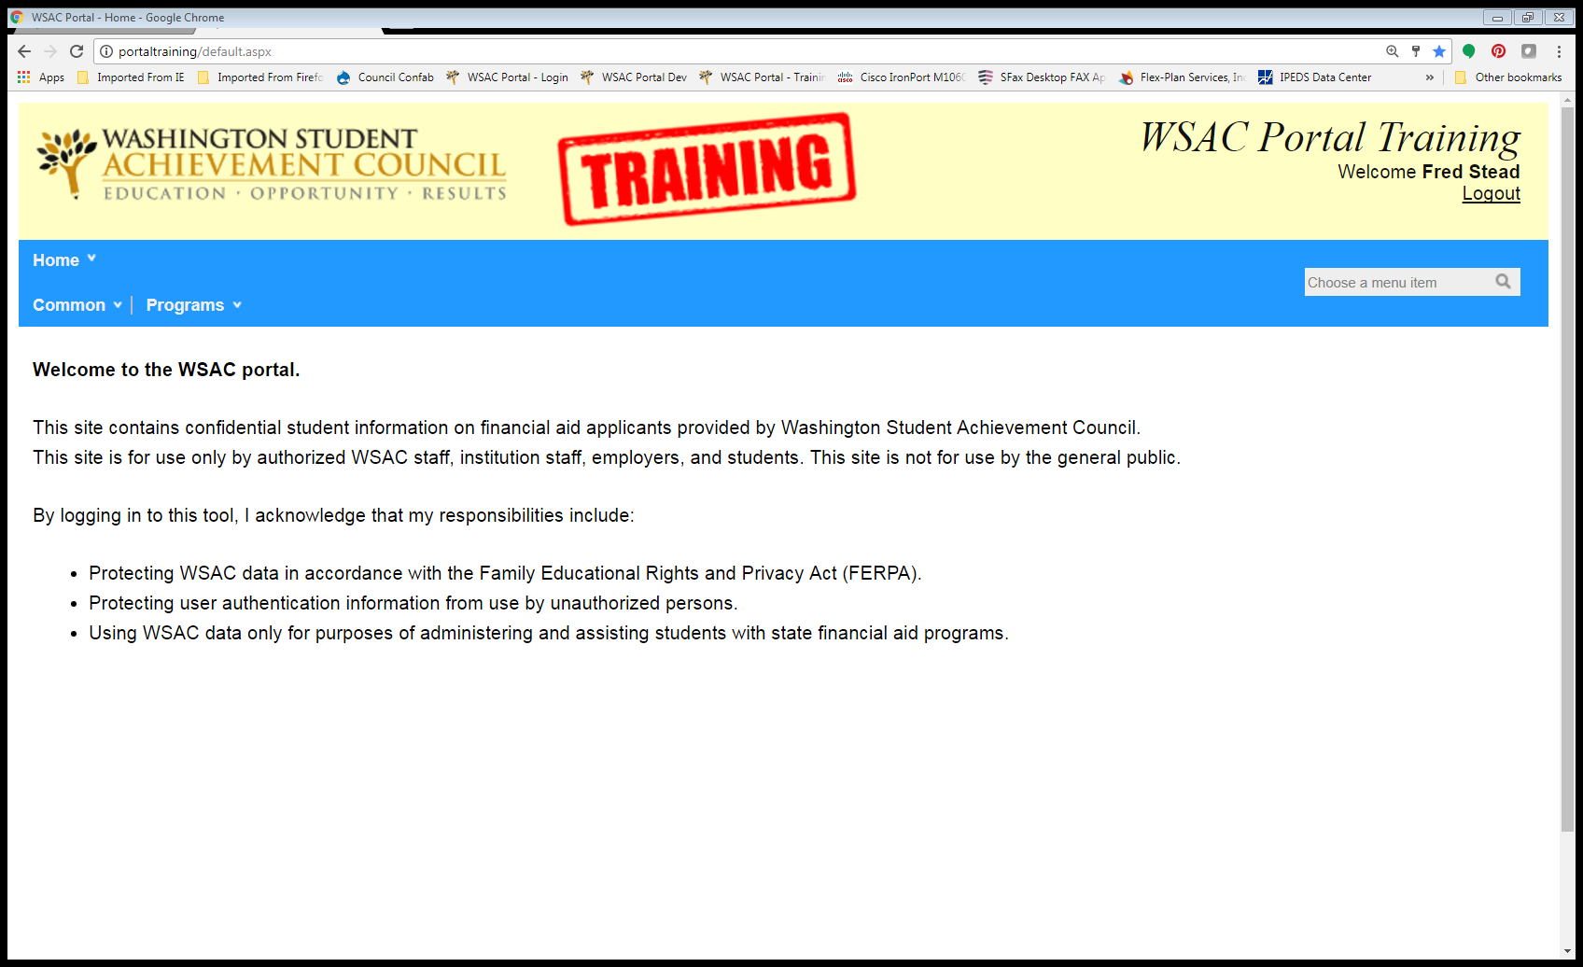
Welcome to the WSAC Portal
Notes:
This is the home screen after you log into your Portal account. It provides a set of menus at the top of the page. At the top right of the screen is your login name and an option to log out of the Portal. Your view will be similar to the one displayed here.
This screen is Hyperlinked to the Portal. Need to make sure though that the link links to and then point to the options under the dropdown list(s). If no Internet is available, make sure to go through the options in each dropdown box. Read the screen out loud.

Slide 31



Menu Selections
This view is a screen shot of the options under the ‘Common’ and ‘Programs’ dropdown boxes.
‘Common’ Menu Selections
  Change Your Password screen.
  Messages & Files screen.
‘Programs’ Menu Selection
  Depending on the program(s) you work with, this drop-down box will differ. For instance, if you already have access to the College Bound program Portal or the student FAFSA data, these choices will also display here. For this example GEAR UP is the only program this user has access to, therefore it’s the only one displayed.
Notes:
Since we’ve already previously discussed changing your password, on the next slide I’ll show you the Messages and Files screen.

Slide 32
Messages and Files: Secure Messaging
Do not send personally identifiable student information through email.
Do not share with us confidential student stories.
Use the Portal Secure Messaging to:
  Send Priority Eligibility verification forms.
  Send Middle School Math Completion forms.
  http://www.gearup.wa.gov/file/priority-model-verification-instructions

Slide 33
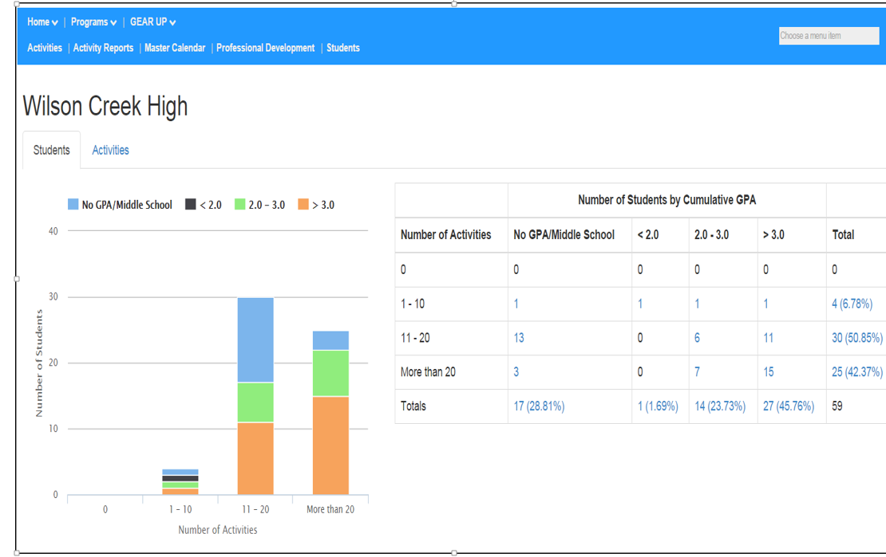
GEAR UP Dashboard –Student Tab
GEAR UP High School
Notes:
Point out the different options at the top of the screen now, the Activity, Activity Reports, the Master Calendar, Professional Development, and the Student tabs.
The GEAR UP dashboard is a tool for GU sites to track their current activity data. There are two tabs associated with the Dashboard, the Student Tab, and the Activity Tab. The Student Tab track the data in relation to a Student’s GPA. Point out here the choices at the top of the screen.

Slide 34
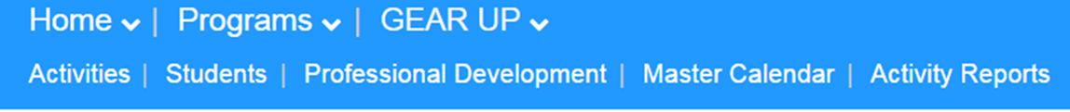
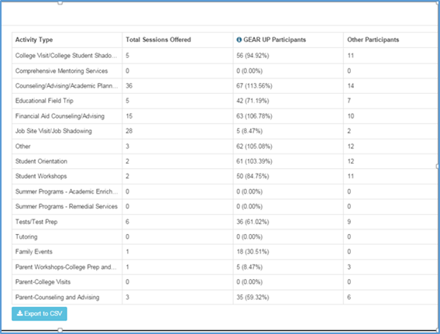
GEAR UP Dashboard – Activity Tab
Notes:
The activity tab displays your students’ GU activity participation compared to other same-model (Priority, or Cohort) GEAR UP schools. Be sure to point out the CSV button.

Slide 35
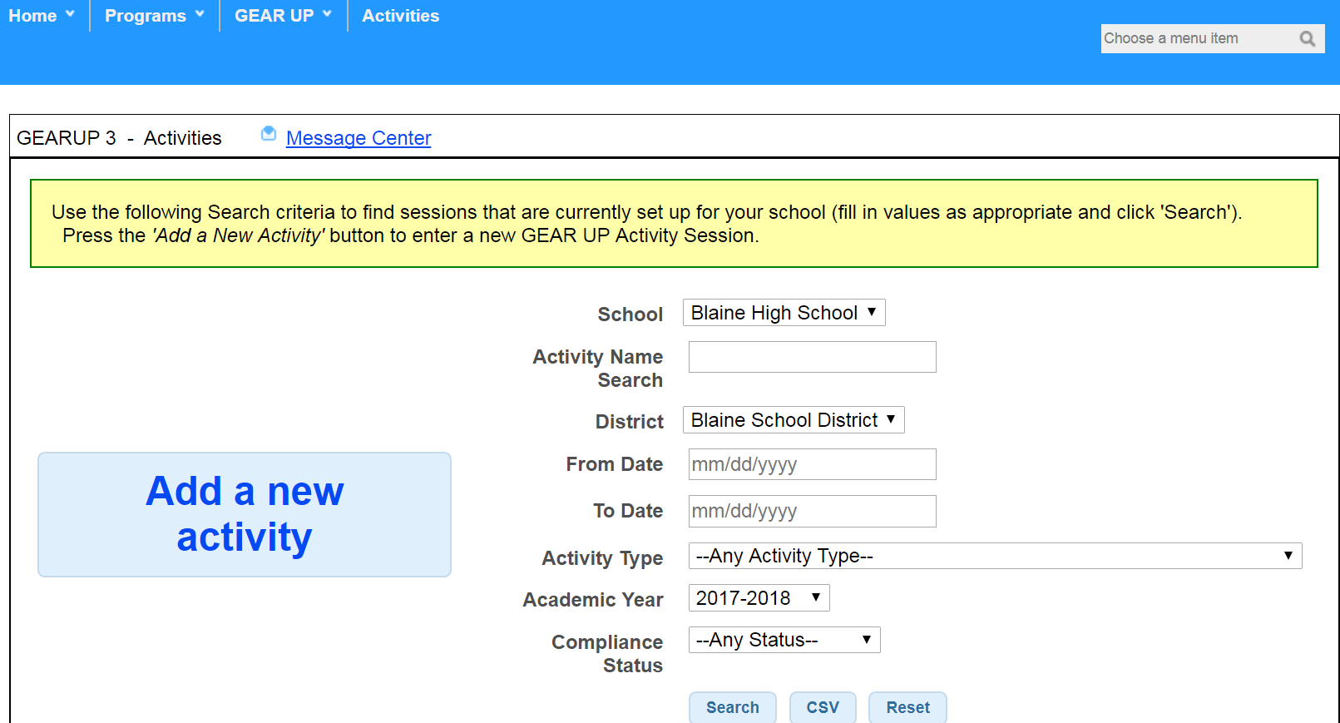

The Activity Screen
GEAR UP SD
Notes:
The activity screen is where you’ll add new activities, search for activities that have been already entered, and manage the activities that you have already established for the current academic year. To add a new activity, you’d click on the ‘Add a new activity’ box in left middle of the page.

Slide 36
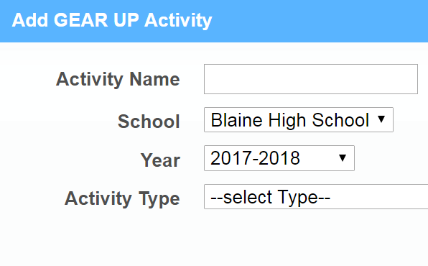

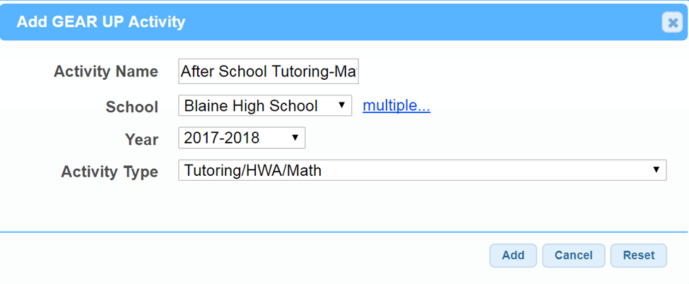

Adding a New Activity
Notes:
Fill in the following information (point while explaining)
Activity name – give the activity a descriptive name; the more descriptive the less compliance questions there are. The activity name doesn’t need to fit in the space allotted for, there is no character limit.
School – This will default to the name of your GU school, or if there is more than one school in your district, select from the school drop-down box.
Year – Will always default to the current academic year.
Activity Type – This is important. Using the GEAR UP Service Definitions handout, choose the activity type from the drop-down of choices. This handout can be found on the GEAR UP Website at www.gearup.wa.gov.
After all this has been determined, click ‘Add’ at the bottom of the text box.
Once you do this you will be taken to the Activity Detail calendar screen.

Slide 37
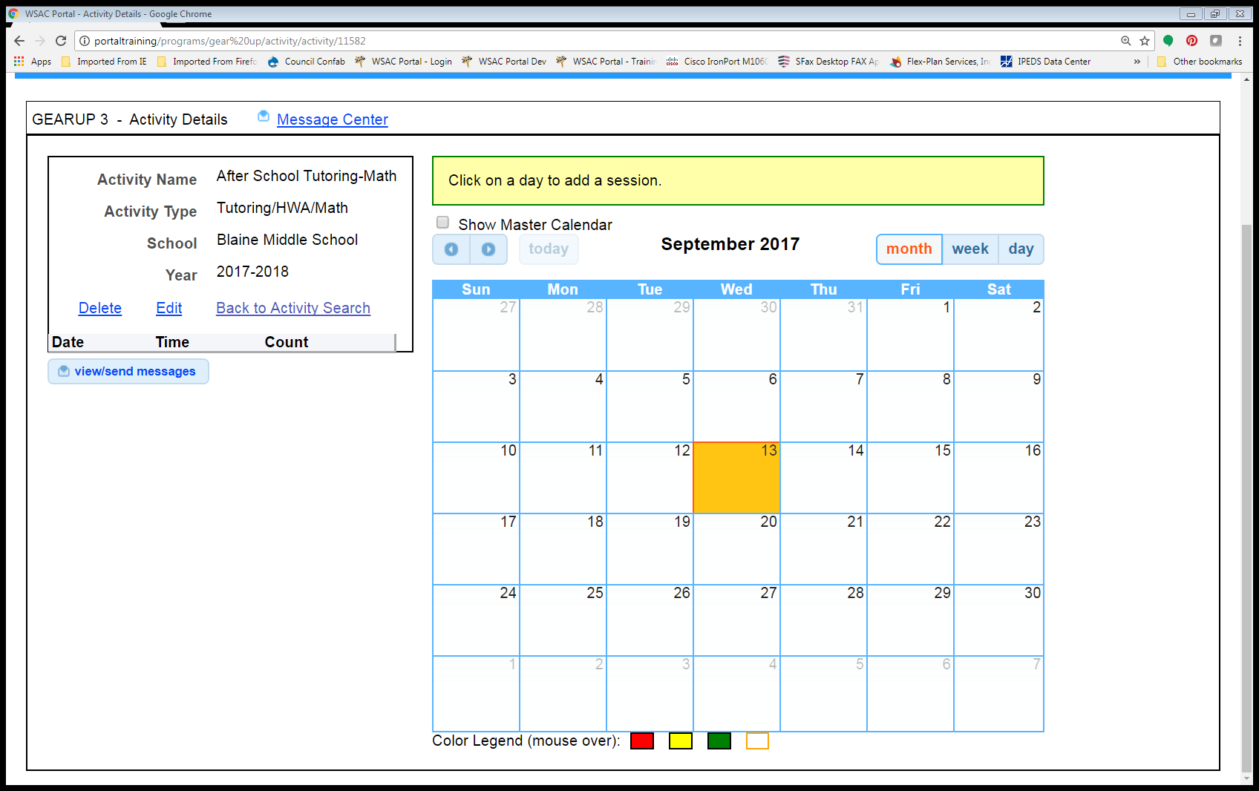

Activity Detail Screen
Notes:
Describe the detail box first and then the process.
The calendar is where the details of the activity are entered by clicking on the actual date of the activity in the calendar itself.
The calendar will always default to the current month, if an activity is being entered for a prior month or future month, scroll to that month using the arrows at the top of the page.
The current date is highlighted on the screen.
Describe the other details of this screen entering an activity that spans the entire school year. Only setting up the activity once. Etc.

Slide 38
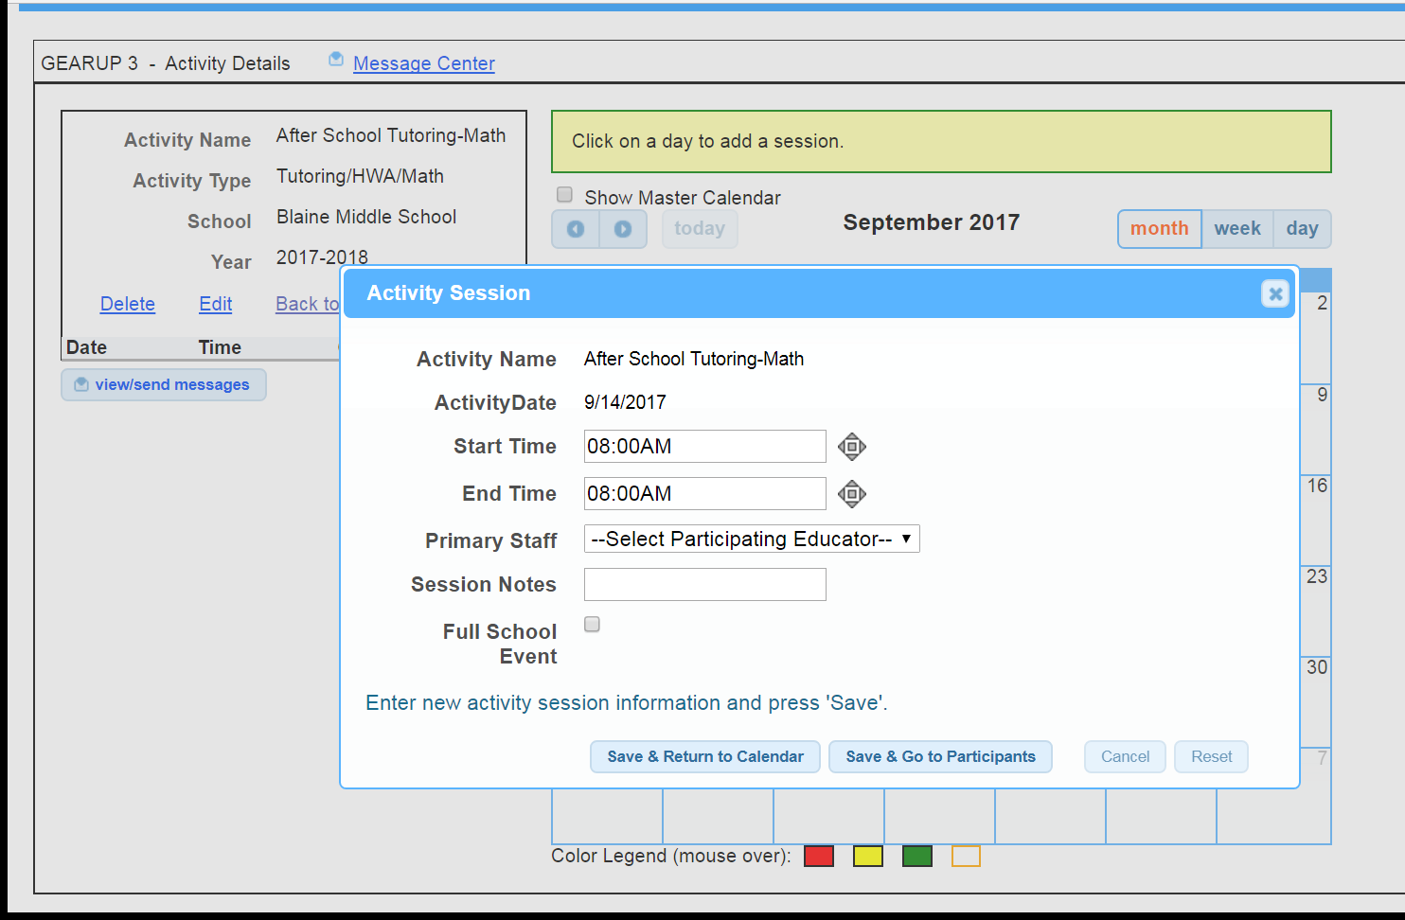
Adding the Activity Session
Notes:
Describe the activity session box, setting up the time, adding the participating education, the session notes, etc.

Slide 39
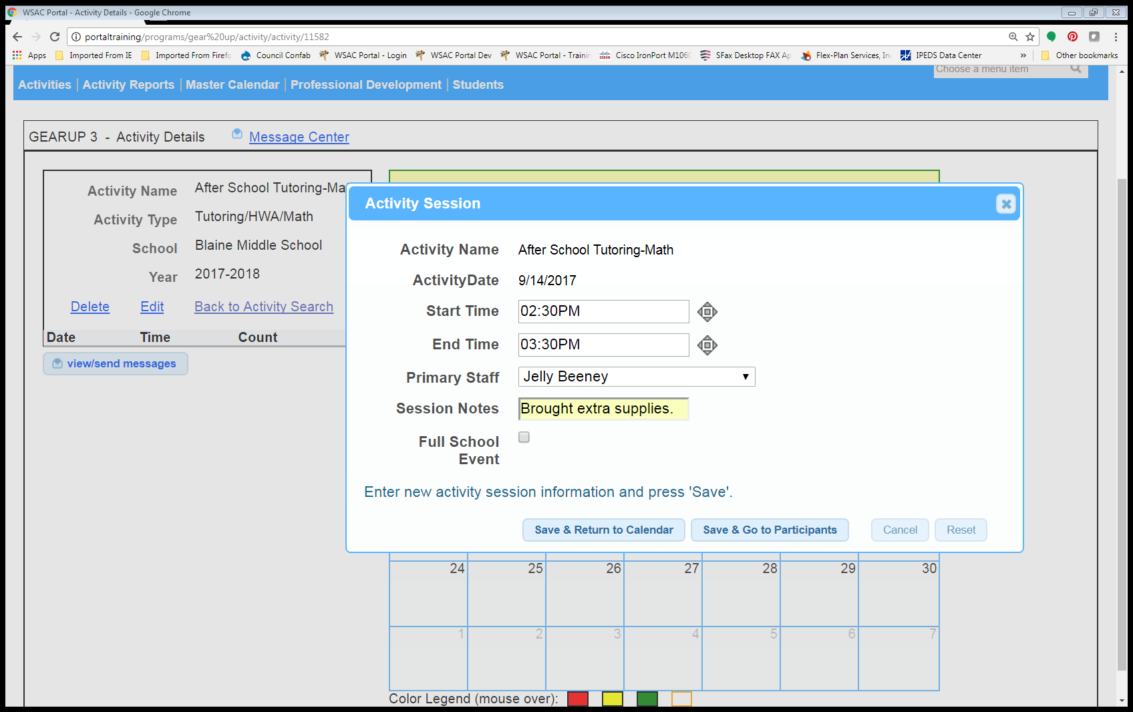

Adding an Activity, cont.
Notes:
Demonstrate how to fill out the activity session box. (If this screen can be hyperlinked to the actual training portal, set up this demonstration ahead of time so that ‘Jelly Beeney’ is added as a staff member, add some extra activities, etc.) Explain ‘save and return to calendar’ and ‘save and go to participants buttons. Explain note section.

Slide 40
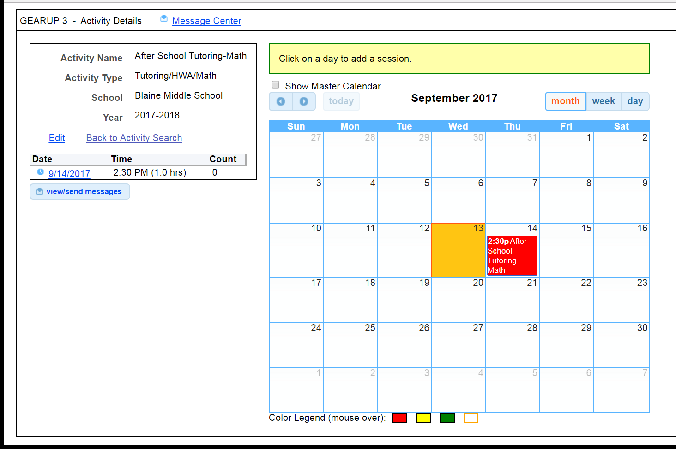
Adding an Activity, cont.
Notes:
Point out the differences in the screen now that the activity is entered. Explain the date links, introduce the next screen where multiple activities will be entered, and the Color Legend comes into use.

Slide 41
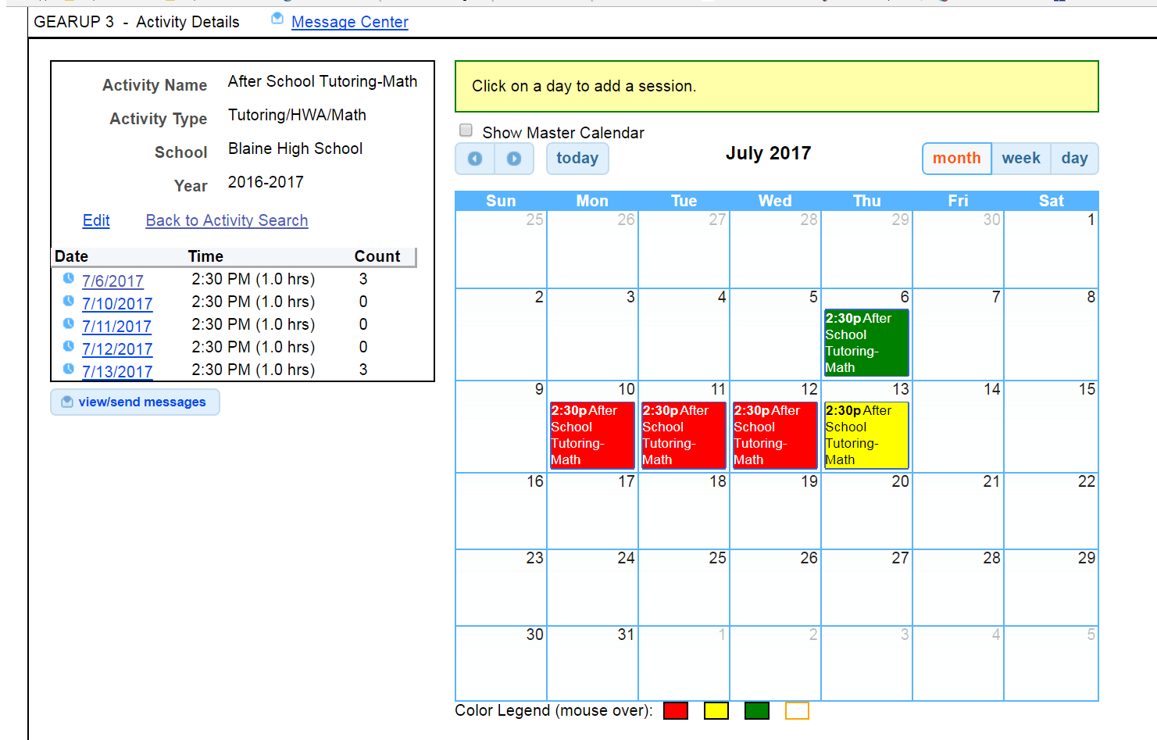

Adding an Activity, cont.
Notes:
Point out the differences in the screen compared to the last screen, color legend equals-
Red - Session has no participant
Yellow – Participants have been added, but no participation time has been entered.
Green – Session roster is complete, (participants & participation time has been entered).

Slide 42
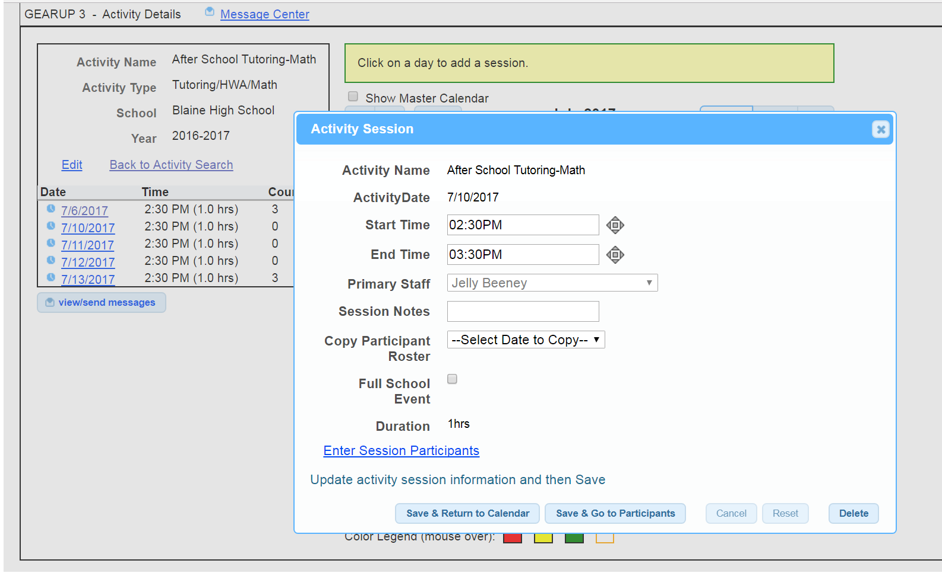

Adding an Activity, cont.
Notes:
Now that the activity is set up, show the activity session pop-up box. Describe the differences in the screen. Describe the different ways you can get to the participant screen. Next screen – participant screen.
You will add a “Primary Staff” person as the lead for the activity. You can choose from the drop down menu, or opt to Add A New Staff Member. There is no limit to the number of staff you can add.

Slide 43
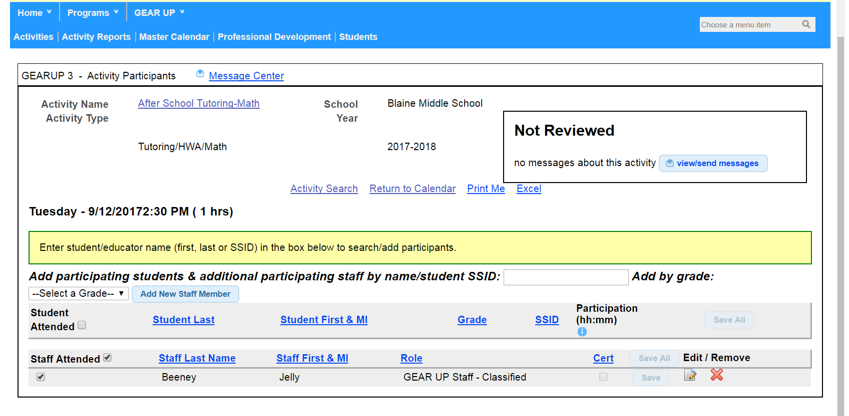
Adding an Activity-Activity Participant Screen
Notes:
Describe the screen. Point to the links, and describe what each link will do.

Slide 44
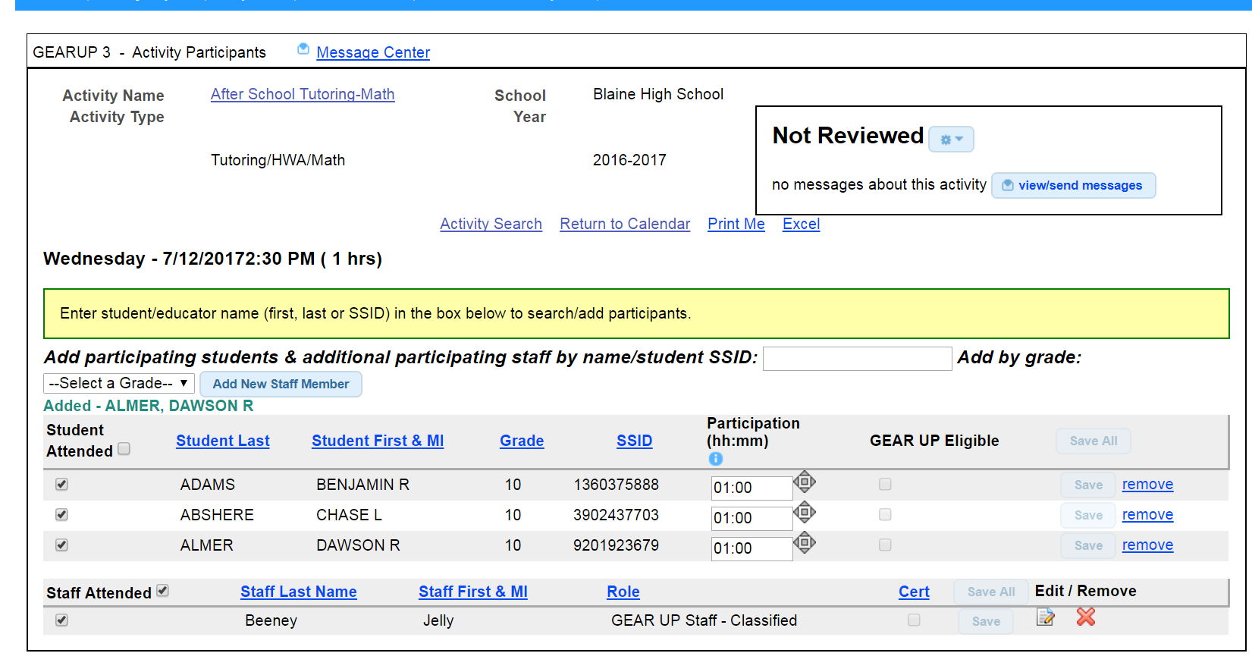





Adding an Activity-Activity Participant Screen
Notes:
Talk about this screen. Point out that the time can be adjusted, the students can be removed from the activity, or just unchecked from the activity. Talk about the ‘Print Me’ function and the Excel functions.

Slide 45
Single Day vs. Multi-Day Activities
Many activities occur on a single day at a specific time.
However, when you have a reoccurring activity:
  Create a single activity.
  Schedule on multiple days.
  Times can be adjusted on each day if needed.
Try to avoid naming activities based on the person providing the service.

Slide 46
For individualized activities throughout the day…
If a service/activity like counseling or mentoring is being provided to students throughout the day:
  Create one activity and schedule for multiple days.
  Enter the time as a full school day (7:30am to 4:00pm, for example).
  When you enter the student participants, adjust their time according to the actual time they received direct service.
  As a reminder, these types of contacts are tracked on the Individual Student Services Tracking Log.

Slide 47
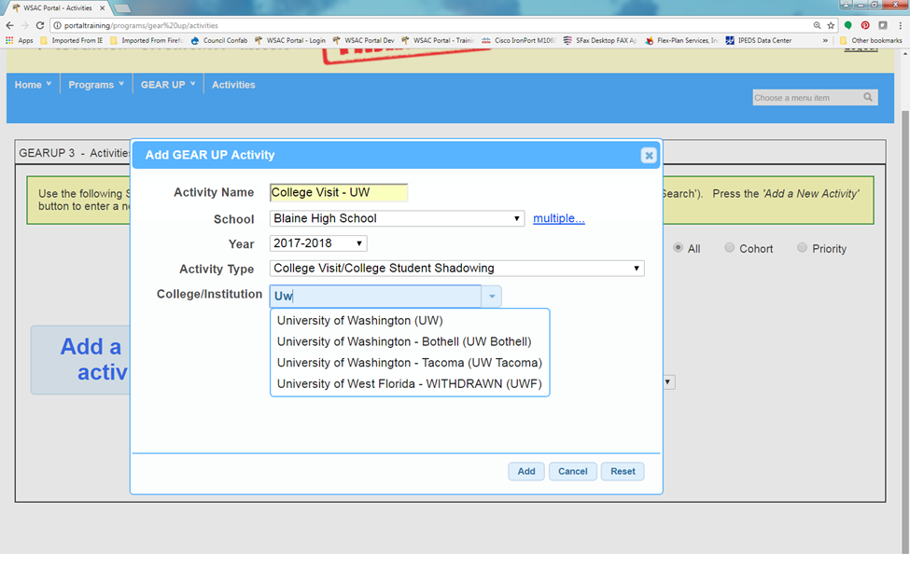
Adding a College Visit Activity
Notes:
Adding a college visit – a bit different then a regular activity. Choosing a college from the drop-down box, if the college doesn’t show up, email me the name of the college, where the college is, and the college’s website. I’ll be able to add the college for you, as long as it has an Integrated Postsecondary Education Data System (IPEDS) number.

Slide 48
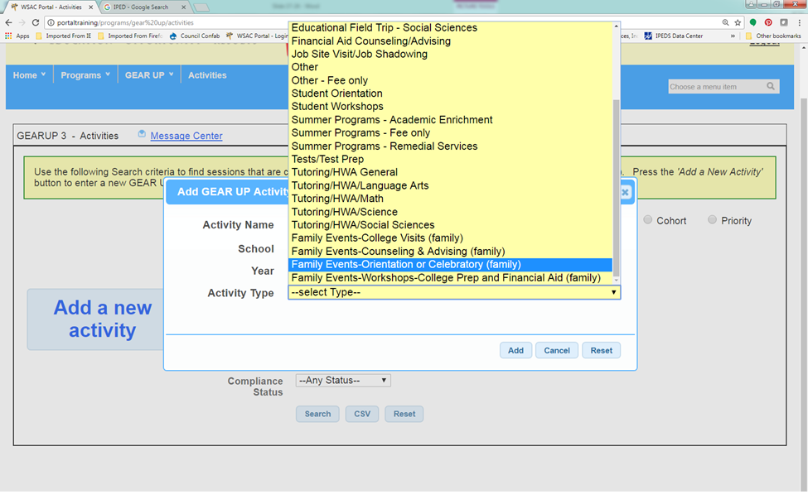
Adding a Family Event Activity
Notes:
The process is similar, please refer to the Activity Type definitions when selecting the Activity Type.

Slide 49
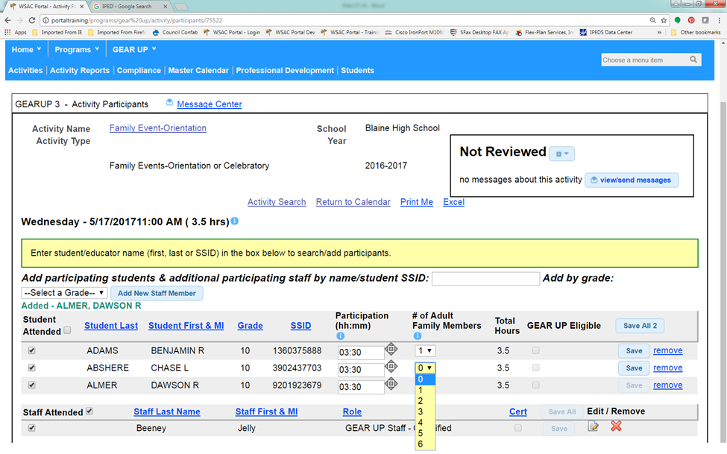
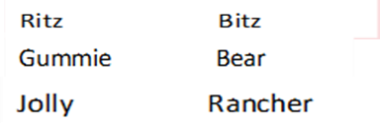

Adding a Family Event Activity (cont.)
Notes:
Talk about adding the family members, and how to save them to the activity after they’ve been entered.

Slide 50
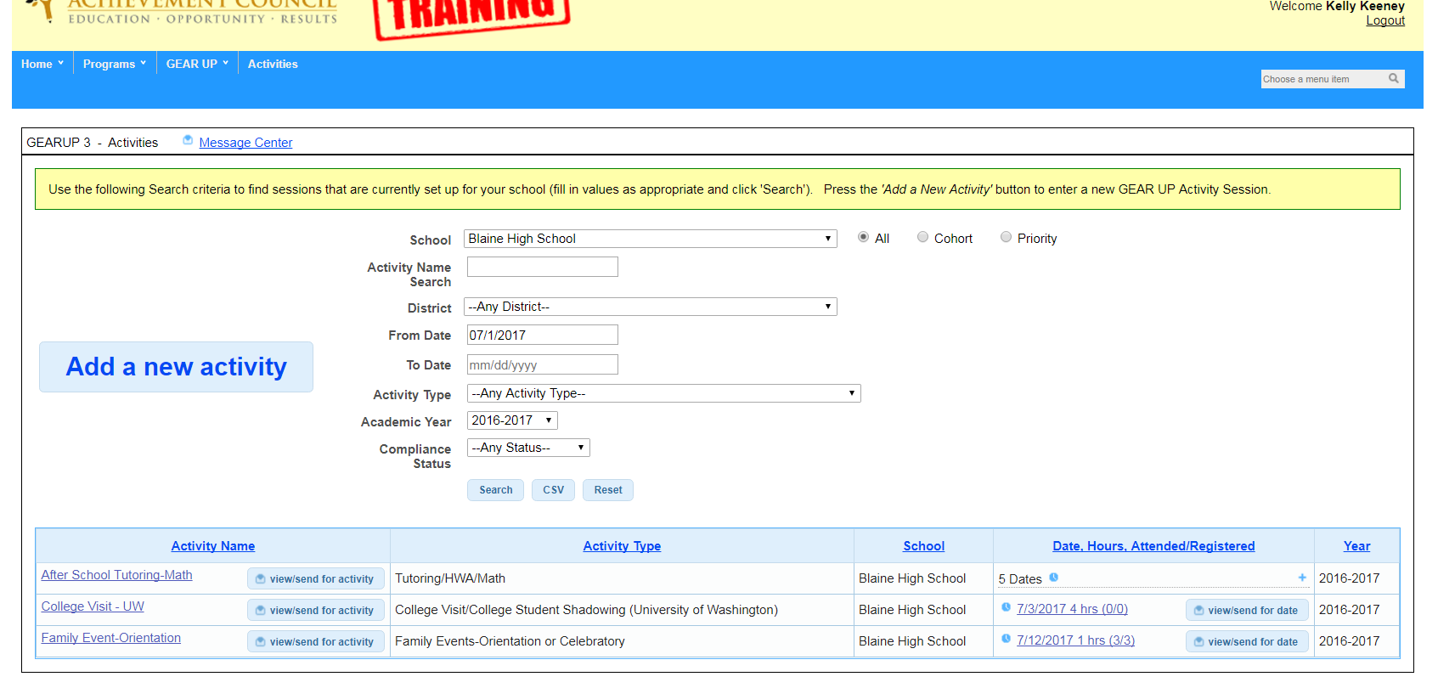
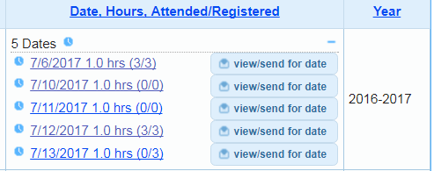

Another Glance at Activity Screen
Notes:
Now that there are activities added, this is how your activity screen will typically look, by the end of the school year there very well could be more than one page of activities. Remember to stress again the importance of using one calendar to add multi-day activities, and how this looks from this screen. How to navigate this screen, sorting searching, etc. Also mention that the different links take the user to a different place, and how to go to the calendar view and how to expand that view, and the participant view.

Slide 51
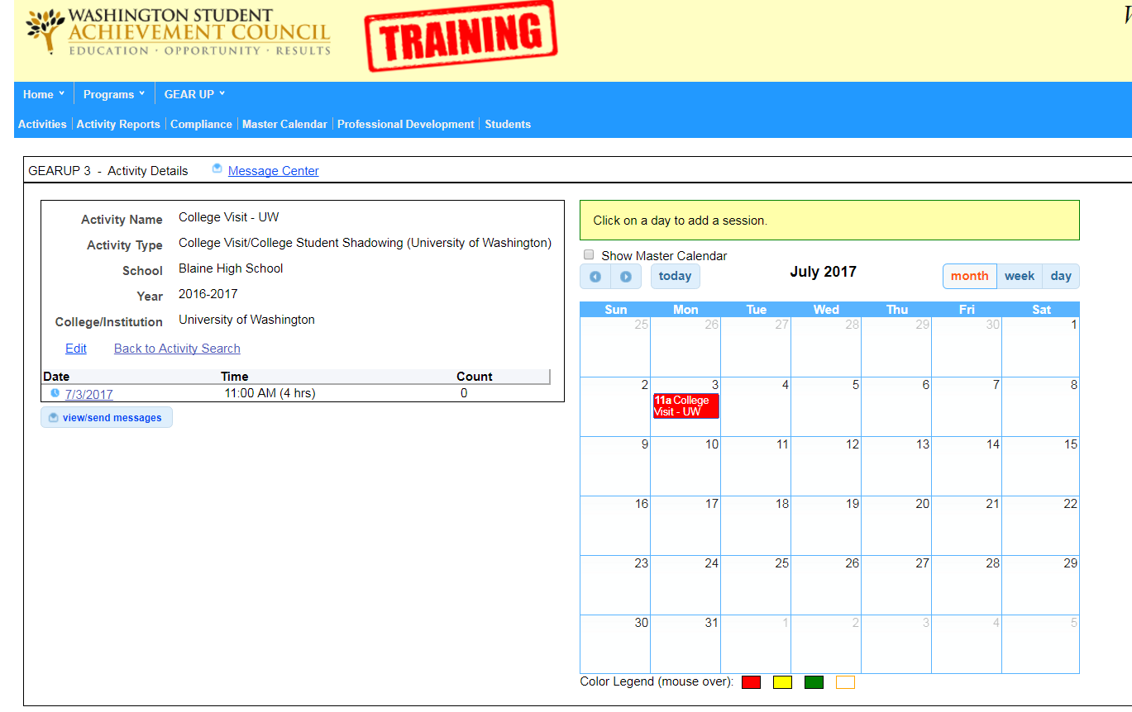
Editing an Activity
Notes:
Editing an activity.

Slide 52
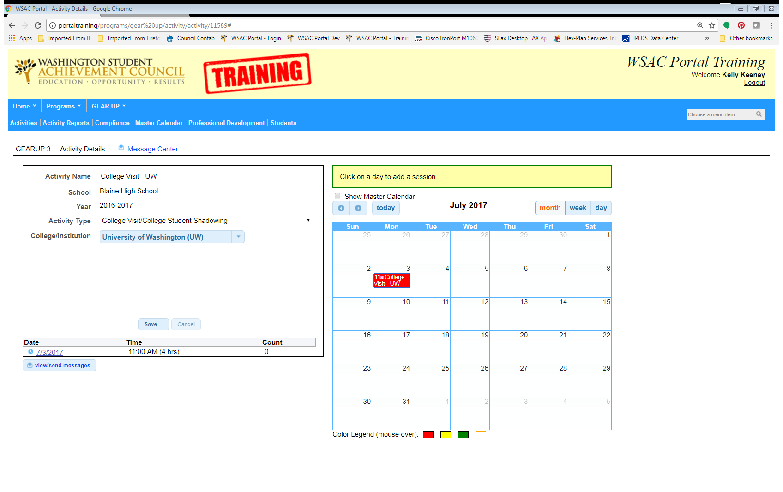
Editing an Activity, (cont.)
Notes:
Editing an activity. You can edit the name of the activity and the activity. This will affect all activities related to the this activity detail calendar. I you have a multi-day tutoring activity, and the activity type is changed from tutoring math to tutoring English, then all the activity associated with that calendar become that activity type. You could talk about however that each date of an activity could be edited for time of day, and length of time.

Slide 53
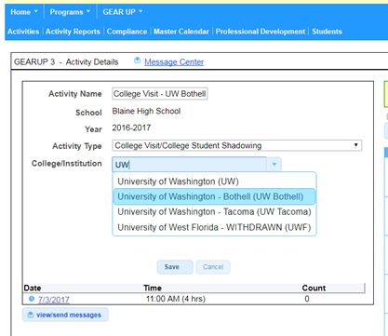

Editing an Activity, (cont.)
Notes:
Editing an activity. You can edit the name of the activity and the activity. This will affect all activities related to the this activity detail calendar. I you have a multi-day tutoring activity, and the activity type is changed from tutoring math to tutoring English, then all the activity associated with that calendar become that activity type. You could talk about however that each date of an activity could be edited for time of day, and length of time.

Slide 54
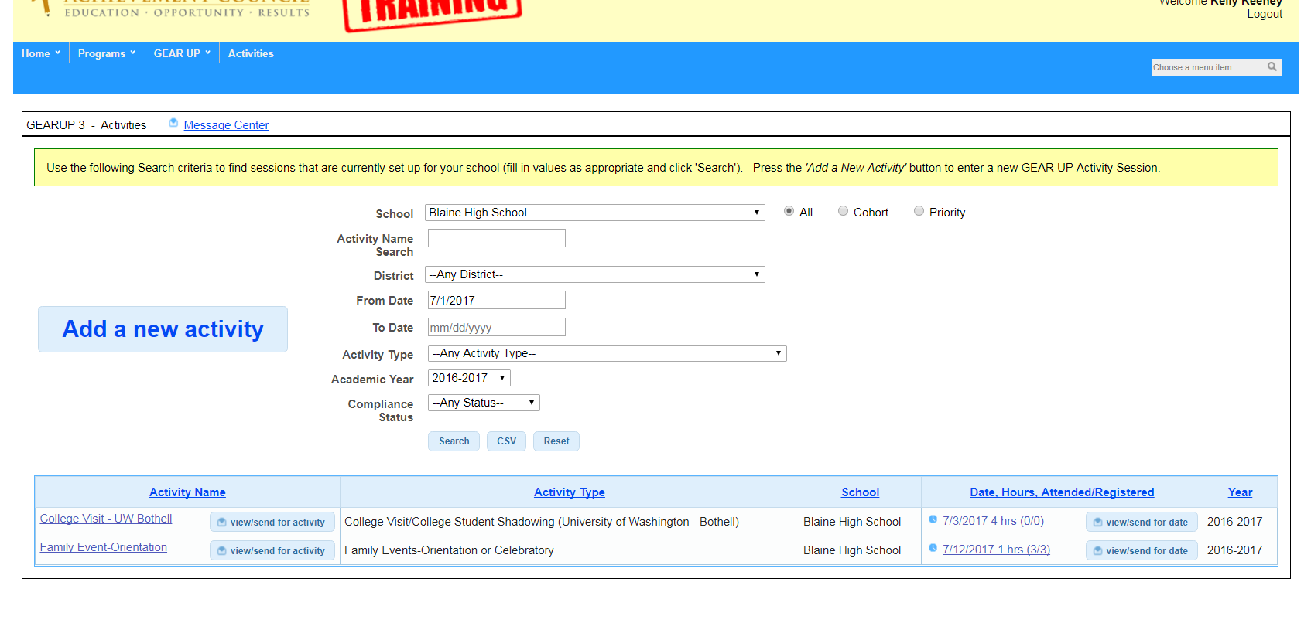

Editing an Activity, (cont.)

Slide 55
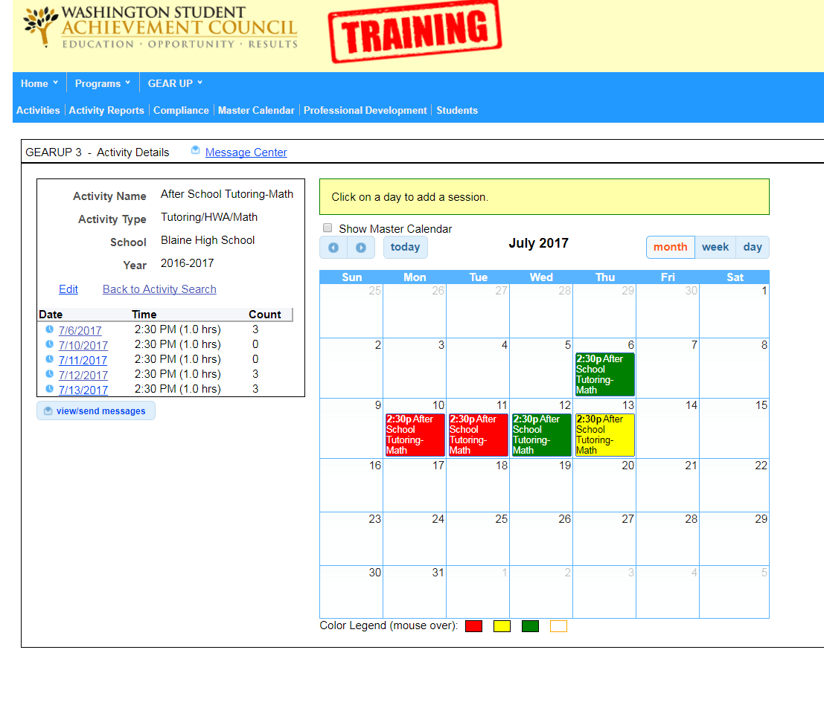
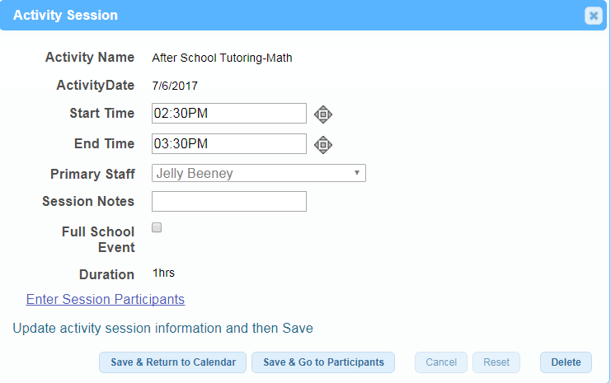
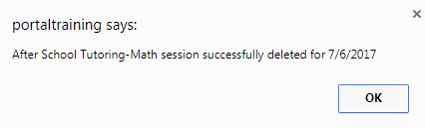
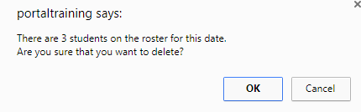
Deleting an Activity
Notes:
Talk about deleting an activity here. Talk about how you have to delete all the activities off the calendar, and then the final activity for the activity to go away completely. Delete the circled activity.

Slide 56
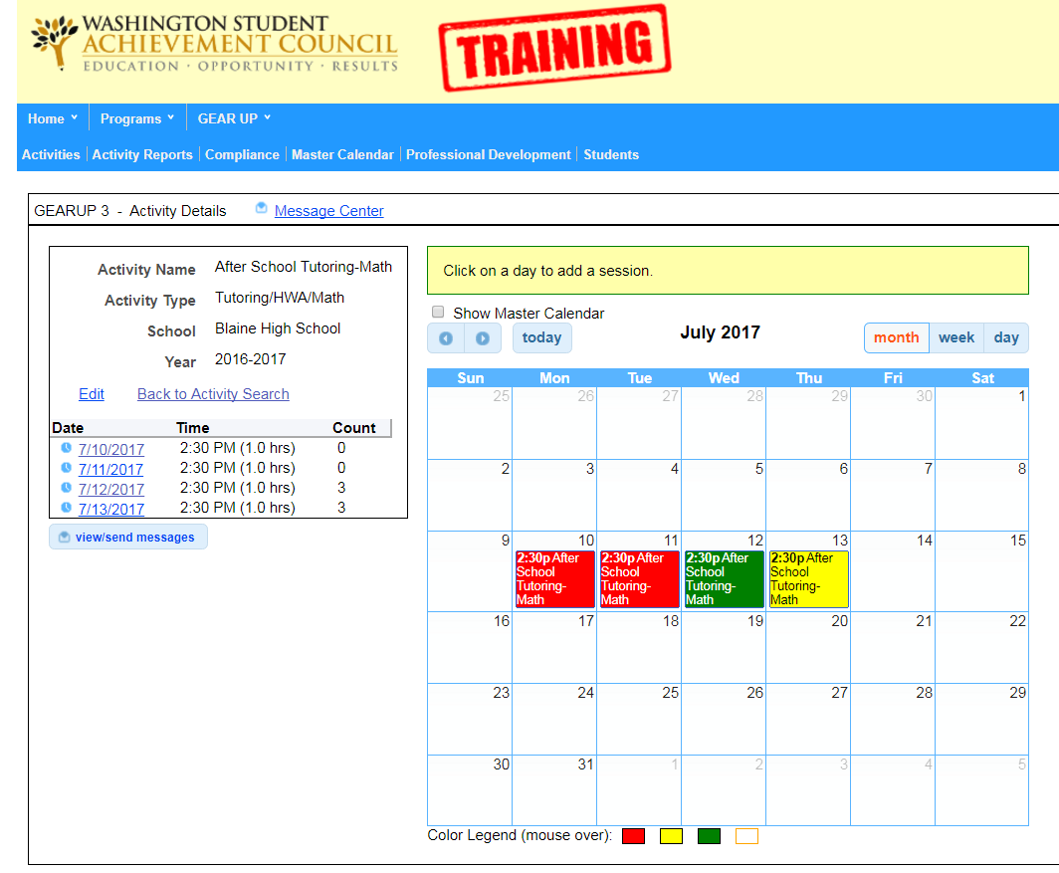
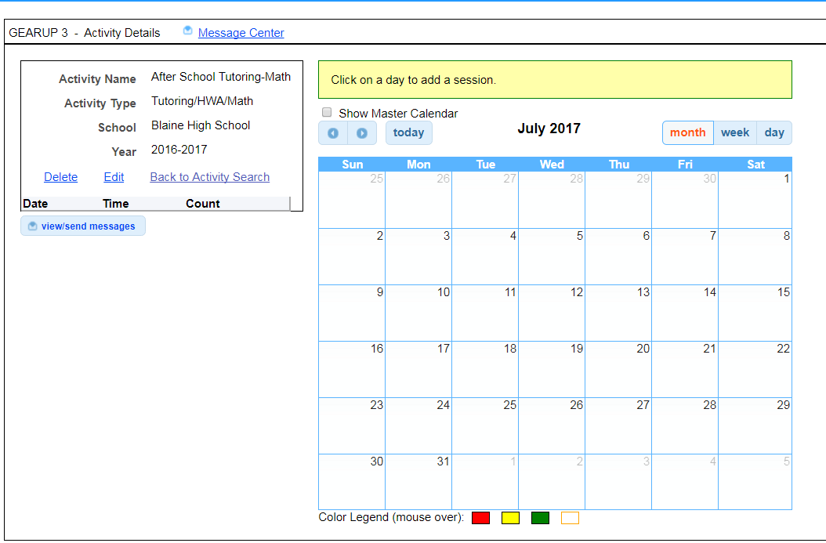

Deleting an Activity (cont.)
Notes:
Point out that only the date of the activity has been deleted, not the entire activity.

Slide 57
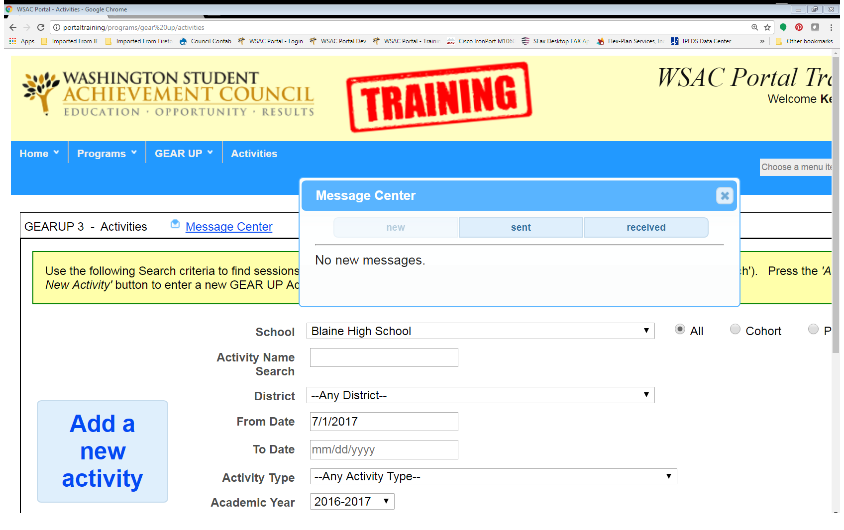
Portal Compliance & Messaging System
Notes:
The portal message system acts as a conduit between a specific activity and GEAR UP staff. Each time an activity is entered in the Portal it is reviewed by GEAR UP staff and the activity is then marked as ‘In Compliance’ or In Review”. If it hasn’t been reviewed, then the activity will remain in the ‘Not Reviewed’ status.

Slide 58
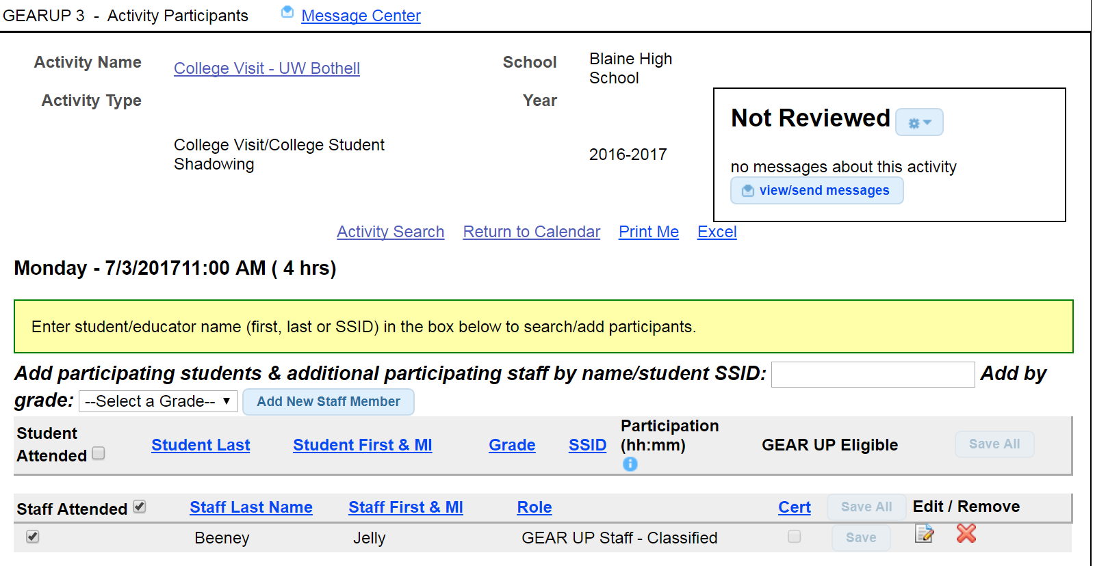

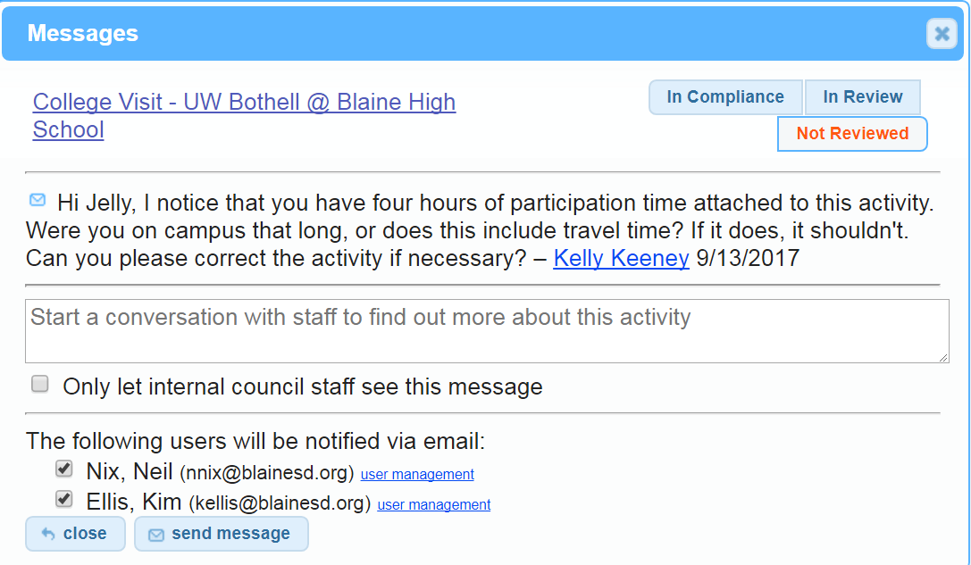


Portal Compliance & Messaging System (cont.)
Notes:
You can use the message system to send messages to GEAR UP, and answer messages that have been sent to you.
Some examples of why an activity might be put in review are:
The name of the activity is too general
The activity happened in a prior month, and no participation time has been entered yet.
The parent participation hasn't been entered on a family event.
The length of time of the activity is too long/short.
The activity doesn’t belong in the Portal.

Slide 59
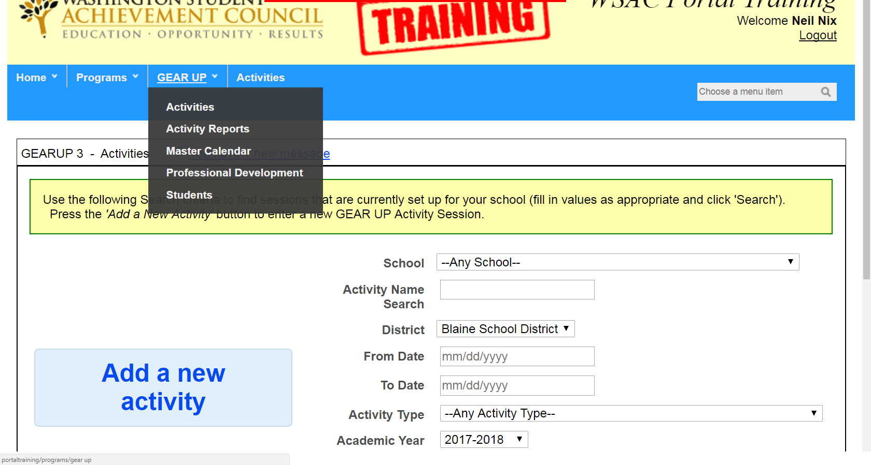
Activity Report Screen
Notes:
The activity report screen allows you to run system reports based on the portal activity data that you have recorded. Currently, the reports are:
Activity Summary by School
Activity list by School
Student Detail by School
Students with Completed College Applications.

Slide 60
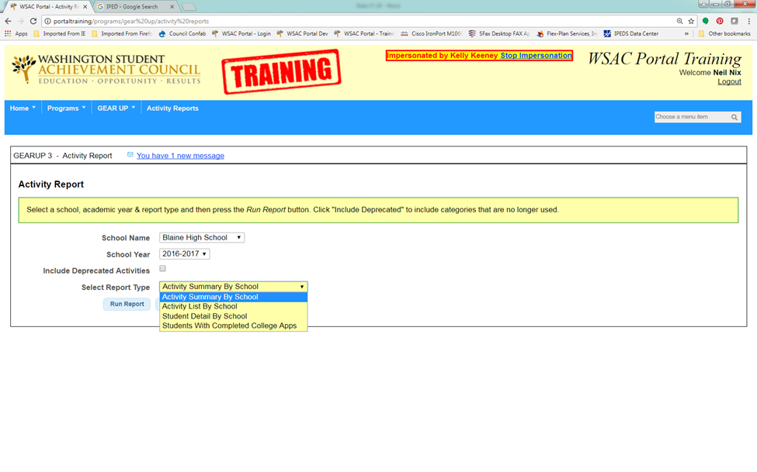
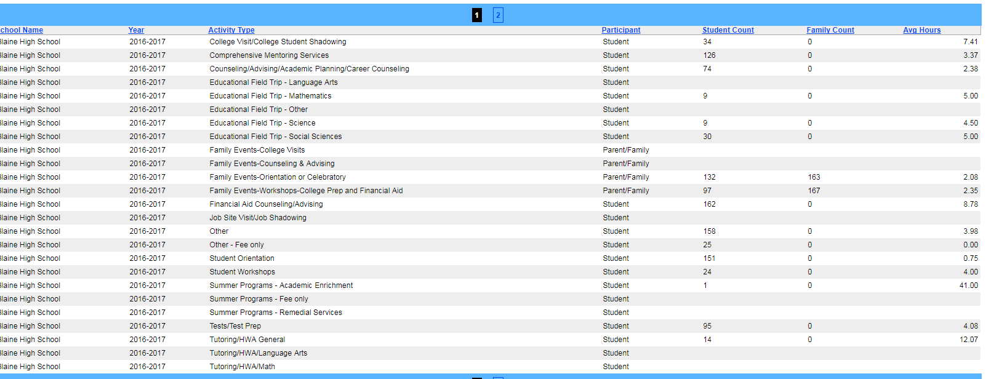

Activity Report Screen
Notes:
The activity report screen allows you to run system reports based on the portal activity data that you have recorded. Currently, the reports are:
Activity Summary by School
Activity list by School
Student Detail by School
Students with Completed College Applications.
All reports can be uploaded to a CSV file, super handy.

Slide 61
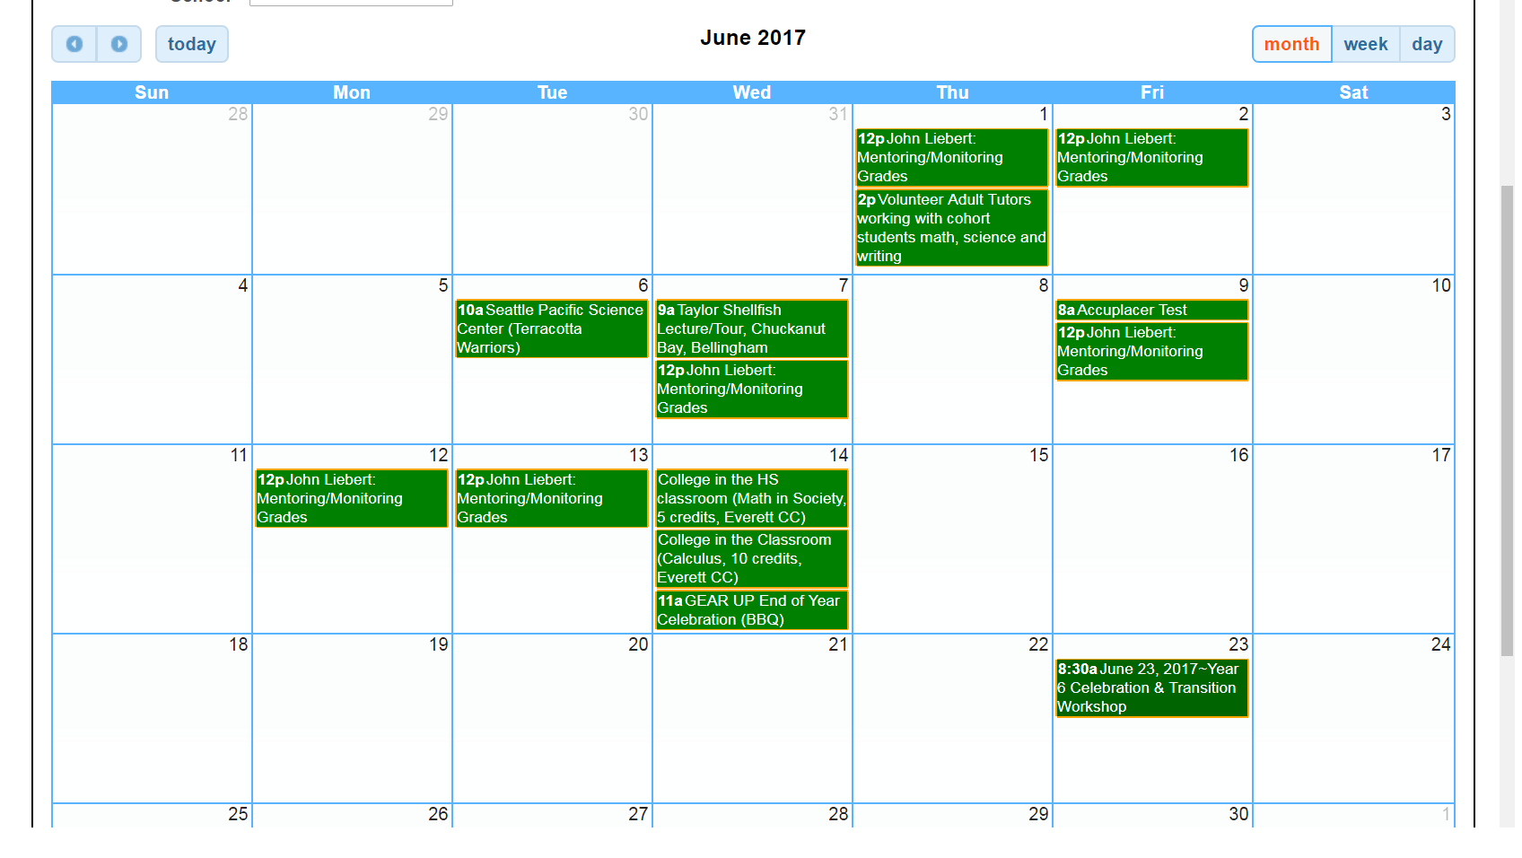
Master Calendar Screen
Notes:
The master calendar screen provides a snapshot of all the different activities you have scheduled, but shown all in one place.
Mention that is any of these activities were incomplete, it would show up here. Will always default to the current month and year, you will need to scroll using the buttons at the top. The calendar can also be viewed by the week, or by the day. Click on an activity in the calendar, and you will connect directly with that activity’s calendar.

Slide 62
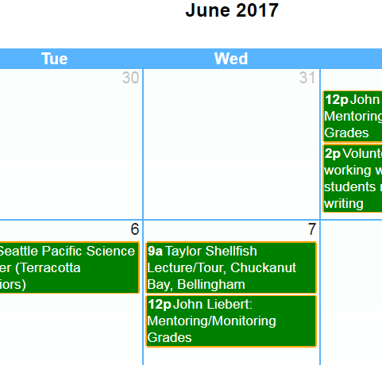
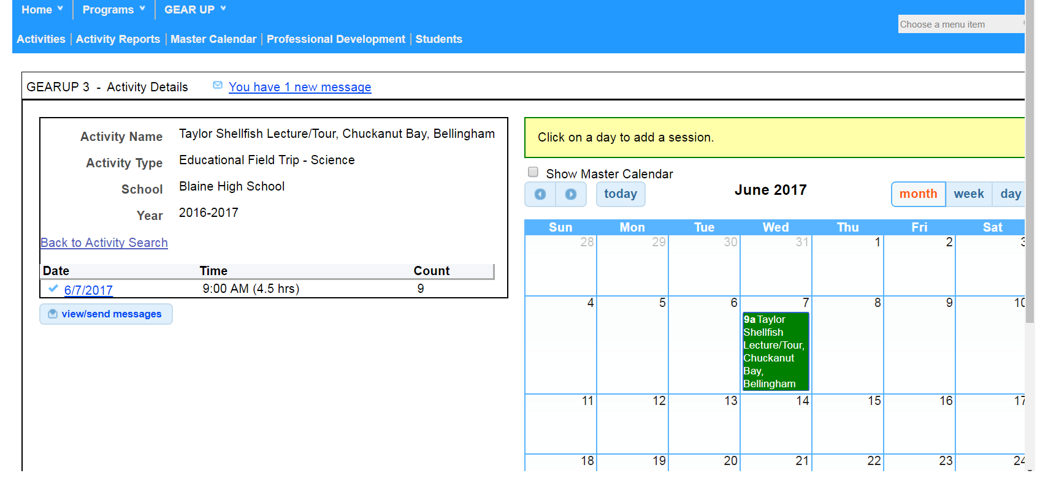
Master Calendar Screen (cont.)

Slide 63
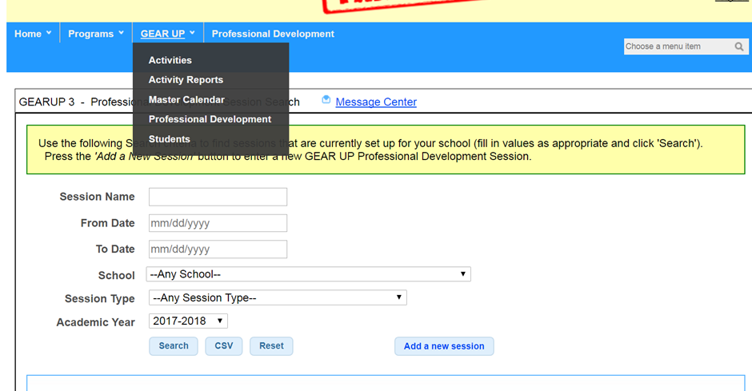
Professional Development Screen
Notes:
All professional development that is provided or paid for by GEAR UP funds is entered in the Portal.
Pro-dev entries are very similar to entering student activities, and the screens look very similar.
The screen mirrors the student activity screen, and the same search criteria apply.
Point and describe – Session Name, From Date, To Date, School, Session Type (instead of Activity Type), and Academic year.
Also on the page, the Search, export to a CSV report, Reset, the Add a New Session button.
Next screen – Add GEAR Session box.

Slide 64
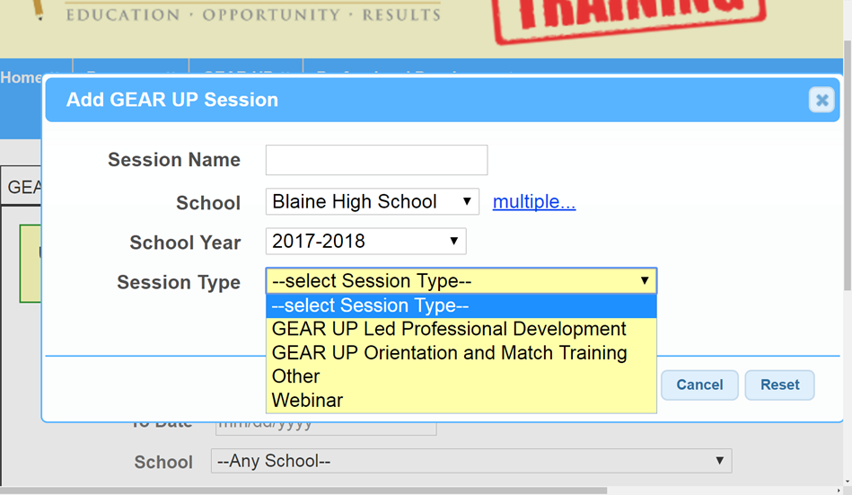
Professional Development Screen (cont.)
GEAR UP MS/HS
Notes:
Four session types, GU Led Professional Development – this workshop would be one of those.
GU Orientation & Match training, as described in your work plan.
Other – any other pro-dev funded sessions, such as AVID, or maybe AP summer institute.
Webinars – self-explanatory.
Any GEAR UP led pro-dev, such as this workshop, will already be entered in the Portal for you, all you will need to do is enter the staff that attended.
Any other professional development you will need to enter yourself, just as you do your student activities.

Slide 65
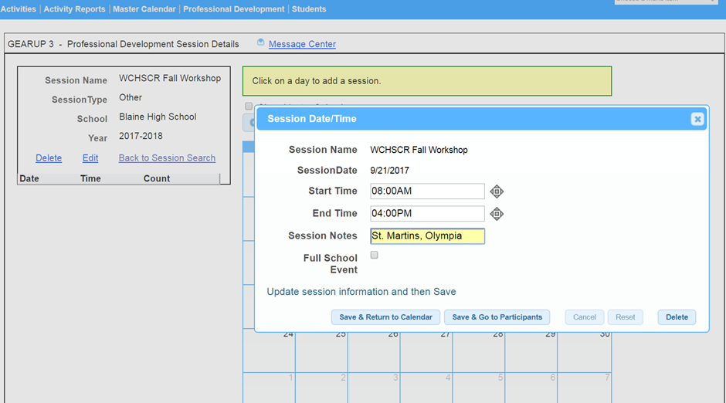
Professional Development Screen (cont.)
Notes:
As with the student activity screen, the process is the same to add the activity

Slide 66
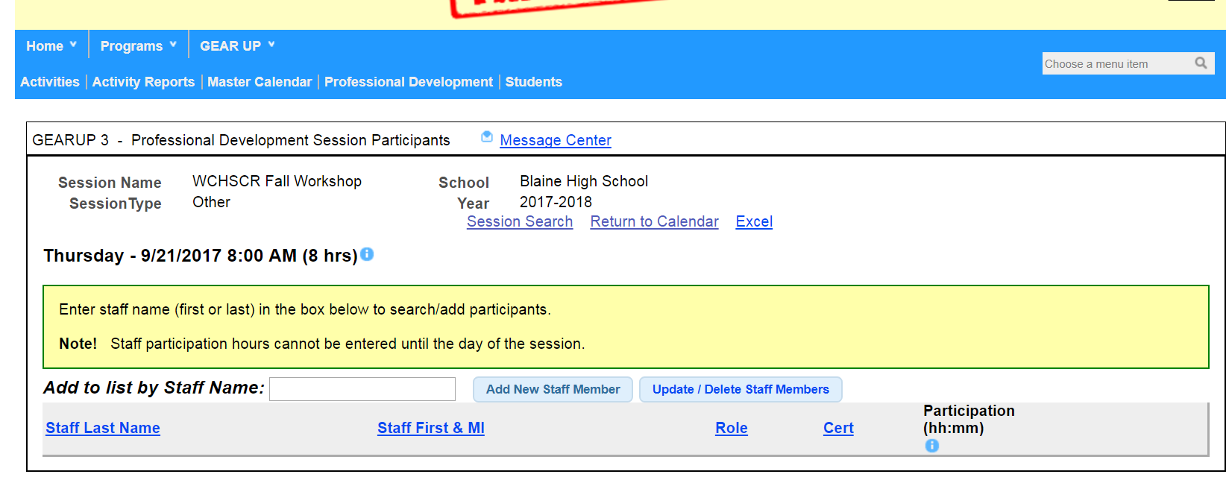


Professional Development Screen (cont.)
GEAR UP MS/HS
Notes:
The most noticeable difference in adding a student activity vs. a pro-dev activity is the staff is list is populated by whoever is entering the session in the Portal. For example, for a brand new school, they will need to enter their staff as they enter their pro-dev sessions, but once the staff member has been entered in the Portal, they will always show up in the staff list.
Also talk about updating and deleting staff members here.

Slide 67
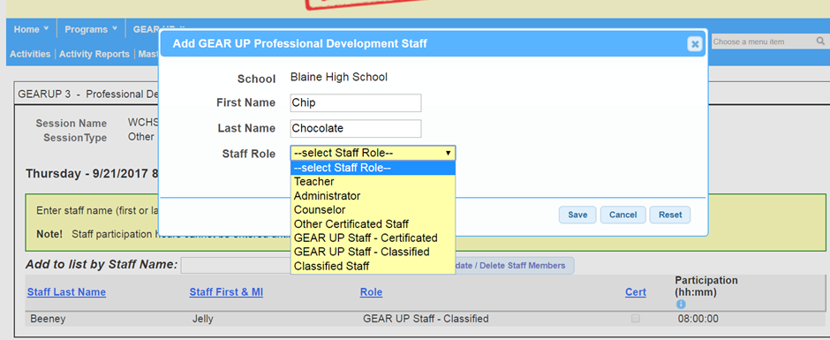
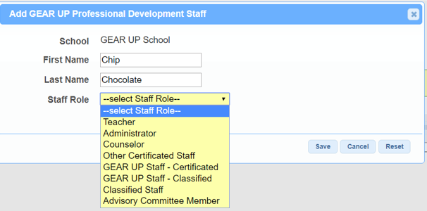

Professional Development Screen (cont.)
Notes:
If staff member is is new to WA state GEAR UP, This screen displays how to enter a staff member to your roster. You do not need to enter them more than once to your roster.
*New staff role - Advisory Committee Member - select this option to add advisory committee members

Slide 68
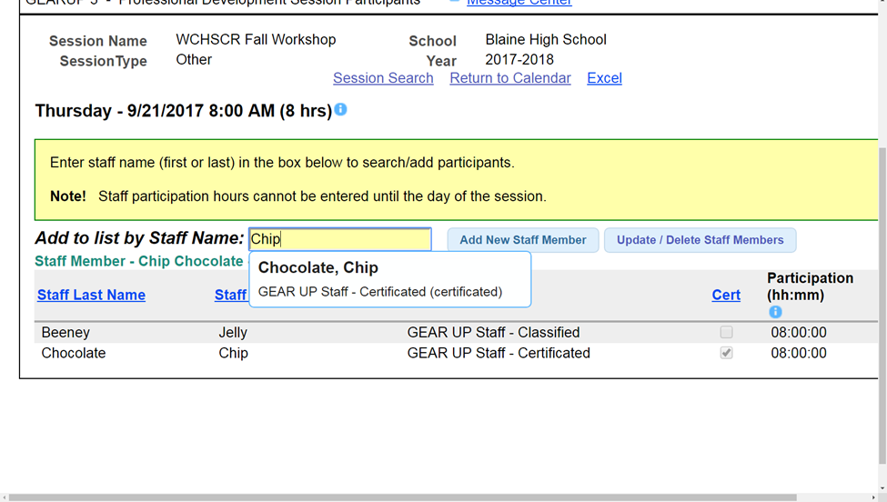

Professional Development Screen (cont.)
Notes:
After they’ve been added they will automatically show up when you start typing their name in the Add to List by Staff Name box, just like the student screen.
If there is someone on the staff roster whose role in the school has changed, or no longer works at the school, keep the list updated by clicking on the Update/Delete Staff Members button.

Slide 69
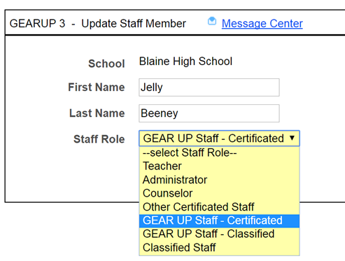

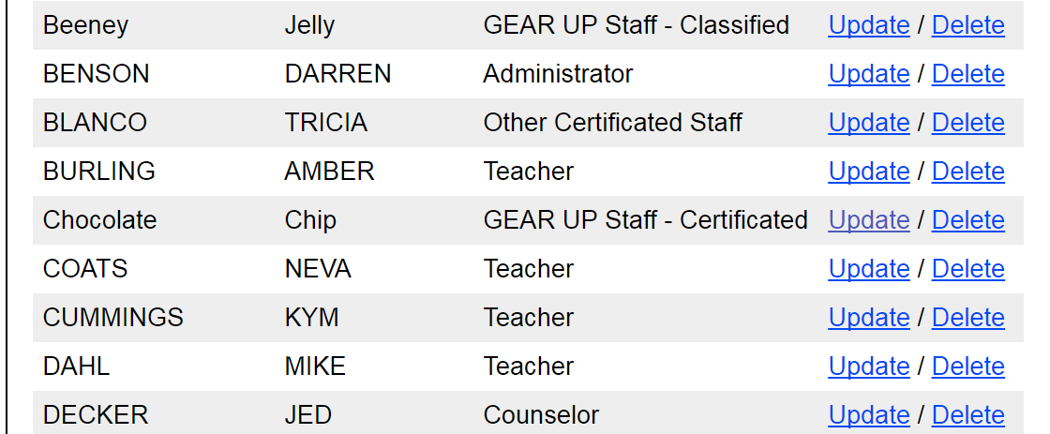

Professional Development Screen (cont.)
Notes:
Talk about the updating and deleting process here.

Slide 70
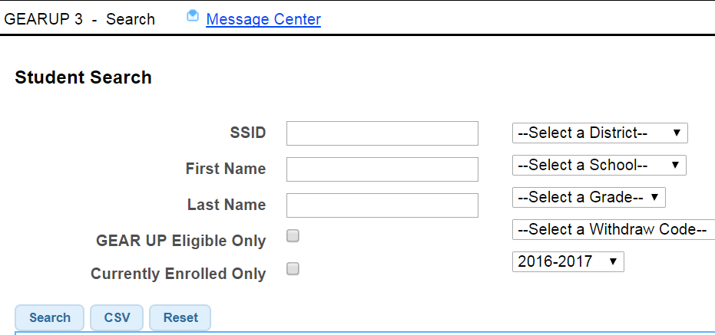
Student Search Screen
Notes:
Use the search parameters on the Student Search screen to find and track individual GU students and family participation data.
The system uses the State Student Identification Number (10 digits, OSPI numbers). This may not be the local school district student ID number.
SSI would return only the student who belongs to that Id number.
First Name – will return all the students in the school with that first name. You can also search by partial name.
Last Name – same as the first name, will return all students with that last name, and maybe even students that have a longer version of that name, i.e. “Rich’ would also return Richmond.
School District only-will return the names of all students enrolled at the high school. If the site is a priority school, then search will be all students in the 7-12th grade. For districts with multiple schools, choosing this option will give you all students in the middle or high school in our district.
The drop-down box will always default to the name of the current school. Once moving to the high school, the Cohort schools have the option of pulling the data from the years that the GEAR UP program they were at the middle school
Withdraw code.
GU eligible only.
Currently enrolled only.
CSV file.

Slide 71


Student Search Screens – Activity Tab
Notes:
From the search screen, if you click on a student’s SSID number, it will take you to the student detail screen. On the activity tab, you will be able to see the total hours of both the student and parents for all the years that the student was enrolled in GEAR UP.
Click on the + sign to expand the detail.

Slide 72




Student Search Screens - College Application Tab
Notes:
College applications completion must be tracked by GU sites for each 12th grade GU student. The College Application tab is where this information is entered.
This information will also populate your ‘Students with Completed College Apps’ report when you run it via the Portal’s activity report feature.

Slide 73

Marking Students Accepted to College
Notes:
Once the student starts receiving college acceptance letters, make sure to update the student’s College Apps screen to reflect the changes.

Slide 74

Keeping Track: Students With Completed College Apps Report
Notes:
Every time a college application is added, or updated on the student’s college app tab, it is also added to the
“Students with Completed College Apps” report.

Slide 75

Student Search Screen – Notes’ Tab
Notes:
This information can only be found on this page, meaning, there is no other screen anywhere else in the Portal that these notes are provided, or can be seen.

Slide 76




Priority Schools: Securely Submitting your Eligibility Verification Reports via the Portal:
Notes:
1. Under Common, select Messages and Files, and then select Inbox.
2. Click on the Create a new secure message to WSAC link on the top right of the page.

Slide 77


Priority Schools: Securely Submitting your Eligibility Verification Reports via the Portal:
Notes:
3. Select GEAR UP from the Select a Program Mailbox drop down box.
4. Fill in the Subject line accordingly.
5. Select the file (from your computer) that you want to add to the Attachments field, by clicking on the Choose File button.
6. Click on the Attach button.
Add a comment to the blank box, if necessary.
Click on the Send Message link on the top of the page.

Slide 78
Final Reminders
Never send personally identifiable student information through email. Use the portal secure messaging system.
Do not share personal student information with us (stories, circumstances).
Do share good stories with us.
Send copies of newspaper articles, newsletter features, pictures, etc. to us for sharing.
Even better if – post it to our social media!

Slide 79
Questions?

Slide 80
Need more help?
Contact Kelly Keeney to schedule an in-person training session.
360-753-7838 or kellyk@wsac.wa.gov.

