Slide 1

Staff Orientation
Welcome

Slide 2

Agenda
What is GEAR UP?
What is the GEAR UP Work Plan & Budget?
How can GEAR UP Support You?
GEAR UP Match Requirements

Slide 3
Our Team

Slide 4

What Do We Mean When We Say College?
We mean any type of education or training after high school.
There are many options for students after high school including apprenticeships, military, on-the-job training programs, community college certificates, 2-year degrees, & 4-year degrees.
The term college includes all these things.
Notes:
We also use the terms “postsecondary education” and “postsecondary training”.
Many people think college is just a 4 year program, but there are many options. We want students to find the right fit. Explain that this is called “postsecondary education” because it is after (or “post”) high school (secondary education). Postsecondary education is often called “college”. College can be 4-year university, 2-year college or technical college, military training, certificate programs, or apprenticeships.

Slide 5
GEAR UP: Federal Grant
US Department of Education
Washington State Office of the Governor
Washington Student Achievement Council
26 school districts
University of Washington
Central Washington University
Washington State University

Slide 6
GEAR UP State & National Programs
University of Washington (2)
Washington State University (2)
Central Washington University
Washington Student Achievement Council (State Grant Program)
Notes:
Delete

Slide 7
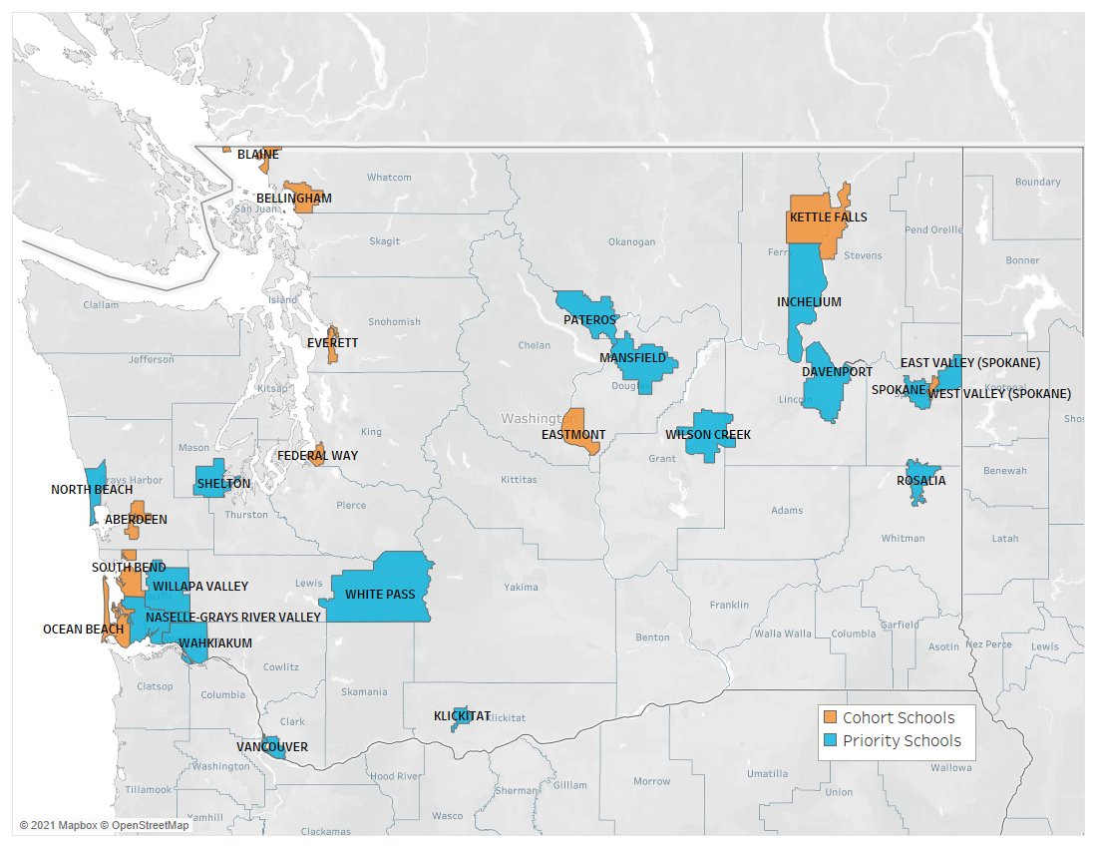
Our GEAR UP School Partners
Aberdeen
Bellingham
Blaine
Davenport
East Valley
Eastmont
Everett
Federal Way
Kettle Falls
Klickitat
Inchelium
Mansfield
Naselle
North Beach
Ocean Beach
Pateros
Rosalia
Shelton
Spokane
South Bend
Vancouver
Wahkiakum
West Valley
White Pass
Willapa Valley
Wilson Creek
Notes:
Fix Wahkiakum

Slide 8
Washington State GEAR UP
26 high poverty school districts.
Over 6,000 students and their families are served annually, starting in the 7th grade through the end of their first year after high school.
GEAR UP staff build personalized relationships with students and families to build and support student aspirations for college.
Prepare students for a career with high labor market value that aligns with their aspirations.

Slide 9
The Washington State GEAR UP program facilitates strategic partnerships in order to leverage funding and resources that provide direct, early intervention services to students in high-need schools in order to help them prepare for and succeed in their chosen post high-school pathway.
Our Mission

Slide 10
GEAR UP’s vision is that all students are academically, socially, and financially prepared to enter and complete the postsecondary program or institution of their choice.
Our Vision

Slide 11
We focus on students who are underserved and historically excluded when planning for college.
We believe that students who start early have a better chance of entering college and completing their degrees.
We believe that personal relationships fuel a student’s desire to go to college and are just as important as good grades and financial resources.
Our Values
Notes:
Where did this come from?

Slide 12
It’s an ACRONYM
GEAR UP stands for:
Gaining
Early
Awareness and
Readiness for
Undergraduate
Programs
It is always written as two words, in all caps.
Notes:
DELETE

Slide 13
Program Objectives
Increase academic performance and preparation for postsecondary education.
01
Increase high school graduation and postsecondary participation rates.
02
Increase students’ and their families’ knowledge of postsecondary options, preparation, and finances.
03

Slide 14
GEAR UP Direct Service Model
Academic support.
College visits.
Family engagement.
Pre-college assessments.
12th Year Campaign.
Dual enrollment.
Comprehensive mentoring.
Washington State GEAR UP prepares students for earning a postsecondary credential that has labor market value and empowers them to choose a path because they want to, and not because they are limited by a lack of preparation.
Notes:
Revise with info from family orientation slide/services, resources

Slide 15
GEAR UP In Our School
Notes:
Leave space so they can add their work plan and budget info

Slide 16
GEAR UP In Our School
Notes:
Leave space so they can add their work plan and budget info

Slide 17
How Can GEAR UP Help You
Notes:
Leave space so they can add the support they can provide to staff

Slide 18
Quarterly Family Workshops
Notes:
Enter your own family workshop /services plan

Slide 19


12th Year Campaign & College Bound Scholarship
Notes:
Schools may wish to share how their GEAR UP activities support financial aid awareness through the College Bound Scholarship and the 12th Year Campaign. If your school plans to host a CBS Repledge event or Financial Aid filing event, can share how you will promote and support students and families.

Slide 20

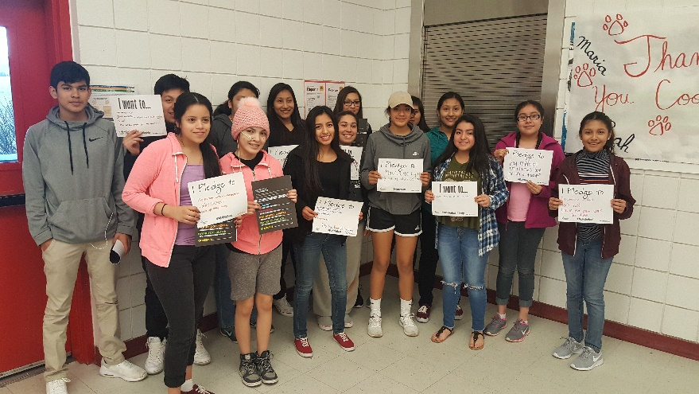
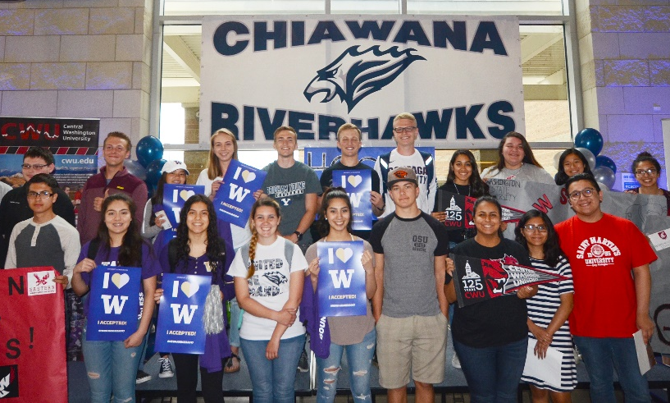
Get Plugged In
Fall
12th year Campaign!
Winter
College Bound Scholarship Repledge
Spring
College Signing Celebrations
Notes:
FAFSA/WASFA: We are working in collaborations with WSAC and individual schools to provide FAFSA and WASFA completion efforts specifically for College Bound students. Please see a regional officer if you have any questions on how to implement targeted strategies for students.
Repledge: The College Bound Scholarship Pledge can be used as a lever to improve student success outcomes for low-income students from 7-12th grade. 9th grade is a critical place to start! We know that 9th grade students earn the lowest GPA, have the most amount of missed classes, and have the highest misbehavior rates. The College Bound Repledge campaign is an opportunity to re-engage College Bound Scholarship ninth grade students in high school and remind them of their commitment.
College Signing Celebrations: College Signing Day celebrates students who have achieved the life-changing milestone of committing to postsecondary options. College Signing Day events motivate students to take charge of their future by completing their education beyond high school. WCAN is working with school districts across the state to empower schools to host their own College Signing Celebrations to highlight students enlisting or committing to obtaining a postsecondary degree or certification. We will be asking schools to celebrate with us throughout the month of May and June or when is best for your school and district.

Slide 21
Understanding GEAR UP Funding Guidelines
Supplement vs. Supplant
GEAR UP regulations require that GEAR UP funds supplement—not supplant.
GEAR UP funds are intended to build the capacity of school districts to create a college going culture.
GEAR UP funding may be used to enhance what is already in place or to create new activities.
GEAR UP funds cannot be used to replace other federal, state, or local funding.
Source: US Department of Education, www.ed.gov

Slide 22
GEAR UP Match Requirements
Definition of Match
  Items donated to the project (school districts share of the program costs)
Definition of In-Kind
  Non-cash contributions of goods or services made by third party individuals or organizations
    Examples include work by volunteers, waivers, donations of supplies, facilities or equipment.
GEAR UP Match Requirement = 50%
Currently the GEAR UP grant requires a $0.50 match for each $1.00 of grant funding. Our school’s grant award is for $__________ and requires a match of $______________.

Slide 23
Match Qualifications
Ask yourself the following question: “Is the good or service an allowable expense that could be purchased using federal funds?”
Match needs to be reasonable, necessary, well documented and consistent.
Details need to be specific and clear.
Generally, the same requirements apply to the cash/in-kind match as they do to the expenditures.
Match must be met in the year of the grant budget. You cannot play “catch up.”
The expense must be:
  Necessary to implement the program.
  Reasonable, in that a prudent person would determine that the cost is appropriate.
  Allocable to the objectives of the award.
  Compliant with the federal administrative regulations that govern the program.
Match cannot be claimed from other sources/programs that are federally funded, such as AmeriCorps, Peace Corps, the U.S. Army, U.S. Marine Corps, U.S. Navy, U.S. Air Force and the U.S. Coast Guard.
Match can only be counted once.
Donations may be counted as match if documented as such.

Slide 24
Teacher Time
Teacher time beyond the contract day, in support of GEAR UP, counts as match. This includes planning time for classroom activities, substitute preparation, developing new rigorous lessons that support GEAR UP objectives, attending field trips, etc.
Teacher time attending GEAR UP sponsored professional development counts as match, including travel time.
All teacher time submitted as match must support the goals and objectives of the program and be in addition to the general tasks expected of a teacher.
The teacher’s normal hourly rate plus benefits is used to calculate the value.

Slide 25
Other School Staff Time: Administrators and Classified
All time devoted to GEAR UP specific activities can be counted as match at the same rate that person is normally paid, including benefits.
All staff time submitted as match must support the goals and objectives of the program and be in addition to the general tasks expected of the employee.

Slide 26
School Counselors’ Time
A school counselor’s time may be counted as match when engaged in GEAR UP activities if they are categorized by your district as an administrator and not as a certificated staff member (teacher). If they are classified as a teacher, then they are only eligible for match if it is performed outside of their contract day.

Slide 27
Thank You!!!

