Slide 1

Growth Mindset & Study Skills

Slide 2
Introductions
Our GEAR UP Team includes:

Slide 3
What do we mean when we say college?
When we say “college”, we mean any type of education or training after high school. We also use the terms “postsecondary education” and “postsecondary training”.
There are many options for students after high school, including apprenticeships, military, on-the-job training programs, community college certificates, two-year degrees, and four-year degrees.
The term college includes all of these things.
Notes:
Many people think college is just a four year program, but there are many options. We want students to find the right fit. Explain that this is called “postsecondary education” because it is after (or “post”) high school (secondary education). Postsecondary education is often called “college”. College can be 4-year university, 2-year college or technical college, military training, certificate programs, or apprenticeships.

Slide 4
The teenage brain is wired to learn!
The brain’s prefrontal cortex, which functions as the control center for executive functions such as planning, goal setting, decision making, and problem solving, undergoes significant changes during the teenage years.
Thanks to the wonders of neuroplasticity, adolescents are primed to improve their performance in school—and beyond. Here’s how to help.

Slide 5

Growth mindset
Intelligence is like a muscle: the brain changes based on one’s experiences and efforts.
A growth mindset means that intellect and talent are not determined at birth or set in stone. They can be developed through dedication and hard work.
Students show greater motivation, better grades, and higher test scores when they understand that through hard work, they can develop and improve their intelligence and abilities.
Notes:
Click video to play

Slide 6
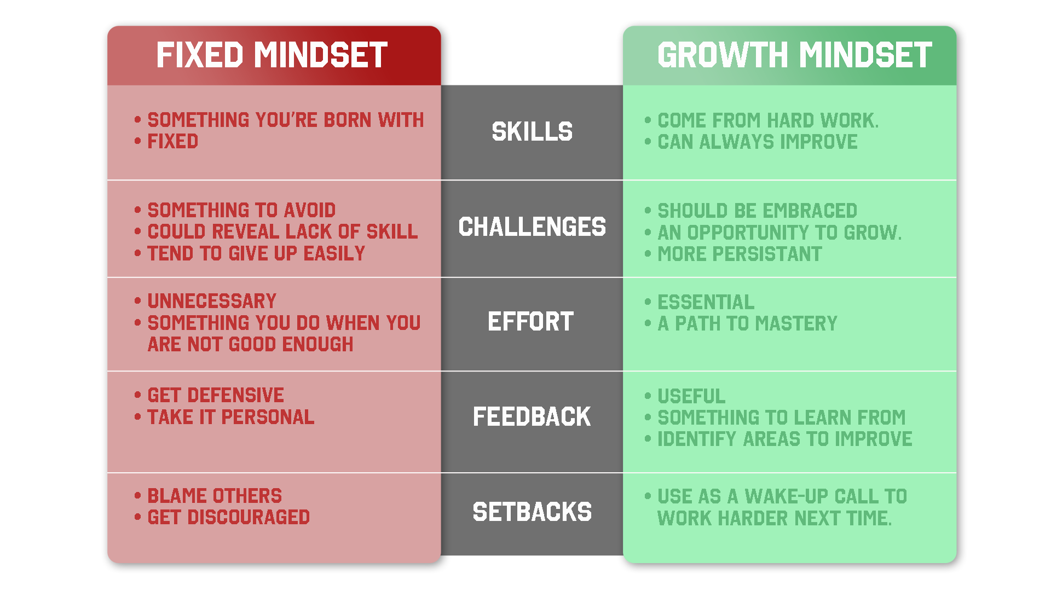
Fixed vs Growth

Slide 7
Key points for families
Praise carefully – not for intelligence but for effort.
Encourage practice and effort.
Encourage child to challenge themselves to grow those brain cells!
Discuss errors and mistakes and help your children to see them as opportunities to learn and improve.

Slide 8
The brain is like a muscle
It grows stronger with challenges.
Success in school is largely determined by the learning strategies students use not by some innate talent.
Students can learn and improve effective problem-solving and study skills to be successful.

Slide 9
Study skills basics
Eat, exercise, and sleep. Physical activity aids in memory. Hunger and lack of sleep can negatively affect your grades.
Have a dedicated study area. Try for a well-lit, organized workspace with few distractions.
Get organized. Have a section for each subject. Label and date papers.
Ask for help. Don’t wait until you are failing. Reach out to teachers or GEAR UP staff to take advantage of tutoring.
Study in chunked sessions. Your ability to retain information diminishes after about 25-30 minutes, so break it up into multiple, smaller sessions. Reward yourself with fun activities during your breaks.
Discover what works best for you and your learning style.

Slide 10
Auditory learner
Use study groups or study buddies.
Listen to audiobooks.
Read out loud.
Talk things out to gain better understanding.

Slide 11
Visual learner
Use images or diagrams to display information.
Read handouts.
Create mental pictures.
Take detailed written notes from textbooks and in class.

Slide 12
Tactile or kinesthetic learner
Works best in hands-on learning settings.
Likes to physically manipulate something to learn about it.
Move about and handle things.
Works well with lab components.
Have an actual object in hands.

Slide 13
Time management
Block off time to study.
Make a weekly or daily “to do” list.
Use a calendar/planner.
Get up early to get stuff done.
Prioritize and schedule what you need to do – be realistic!
Make or join a study group.

Slide 14
Note-taking
Use the Cornell Notetaking System.
If you're more of a visual person, try writing notes using different colored pens.
Create your own abbreviations.
Write down any ideas that the teacher repeats or says is important.
Write down examples.
Rewrite your notes after class. It can help you remember the material better.

Slide 15
Reading
Be an active reader. Think about what you are reading.
Search for cues about the most important content.
Read more than once.
Summarize in your own words.
Don’t put off reading assignments until the last minute.
Read and understand captions and figures.
Pay attention to key concepts and end of chapter reviews.

Slide 16
Test Preparation
Make flashcards.
Rewrite/re-read your notes; reorganize into categories.
Get help if you need it: use tutoring or a study group.
Don’t cram!
Know the test format.
Get all of your questions answered.

Slide 17
Other memory tips
Verbalize what you know –If you can teach it to someone else, you have a solid grasp on the material.
Use chunking. Most of us are able to store only about four to seven different items in our short-term memory (Think about phone numbers). Chunking involves creating something more meaningful—and therefore memorable—from seemingly random bits of information.
Say it out loud/write it down.
Use song or jingles.
Expression or word mnemonics-take the first letter of each word to form a sentence.

Slide 18
How GEAR UP can help
Insert services offered at your school such as homework help

Slide 19
Questions?

Slide 20
Thanks for coming
Contact information:
[insert counselor/advisor/mentor name]
  Phone: (xxx) xxx-xxxx
  E-mail: xxxx@xxxx.xxx

Slide 21
Next Family Night
Topic
Date

